Slide 1

CRF Survey Slide Pack
Designing Adaptable Organisations
for Tomorrow’s Challenges (2018)
Corporate Research Forum
Southside | 105 Victoria Street
London | SW1E 6QT
Tel: +44 (0) 203 457 2640
www.crforum.co.uk | @C_R_Forum

Slide 2
Introduction
Today’s organisations exist in a context of rapid and continuous change, digital disruption, and complexity. The key challenge for organisation designers in this context is to balance the organisation’s core tension between agility and scale.
CRF’s 2018 research report, Designing Adaptable Organisations for Tomorrow’s Challenges, explores these issues. We find that organisations’ ability to apply organisation design insights and best practice in order to adapt and remain competitive is underdeveloped.
Our research included a survey that assessed the current pace of change and redesign in organisations, organisational capability for design and for digital, and other challenges related to organisation design, such as credibility with leadership.
This document shares the results of our survey. The data are available for you to use to support your work. For example, the data may help you clarify the challenges and priorities your organisation is likely to encounter as you design your organisation to meet current and future strategic challenges, or may be used to support a case for change in your organisation.

Slide 3
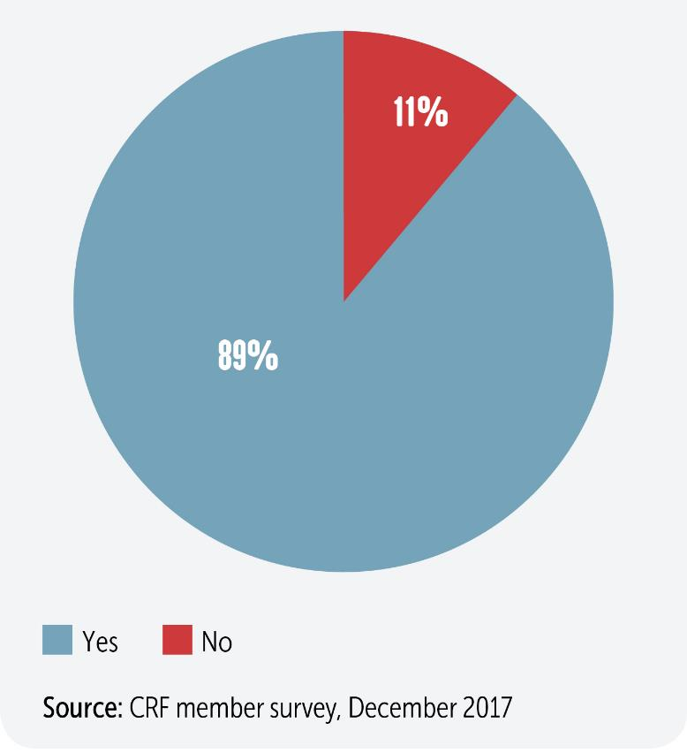
Q1: Has your organisation undergone a significant business restructure/organisation redesign over the last three years, or is one ongoing?

Slide 4
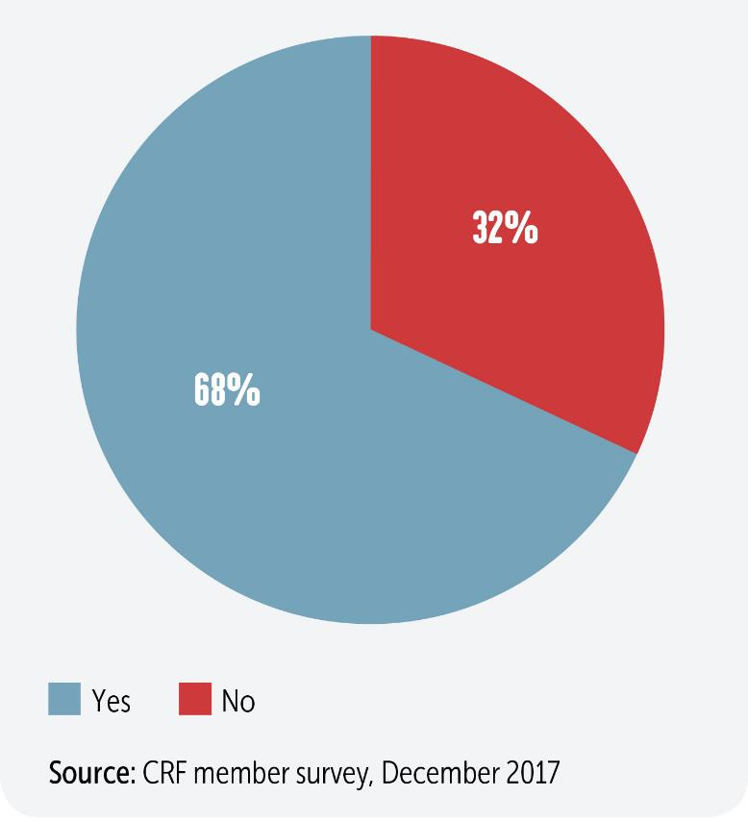
Q2: Is your organisation planning to undertake a significant business restructure/organisation redesign over the next two years?

Slide 5
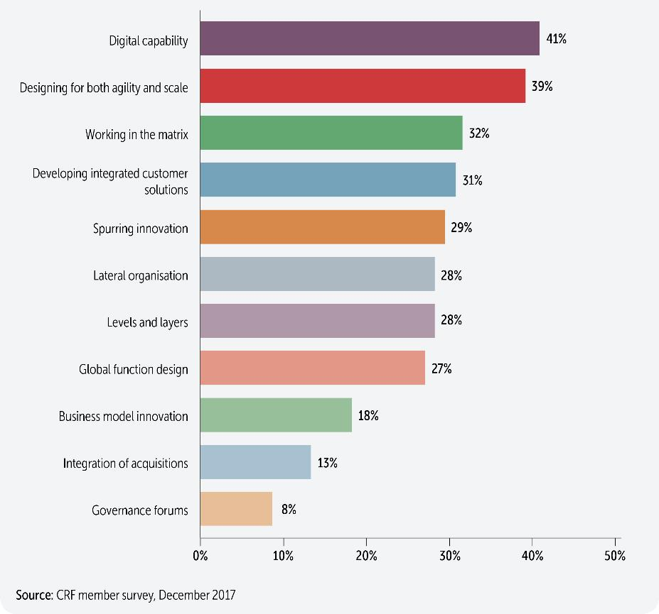
Q3: What organisation design topics are most relevant to your business?

Slide 6
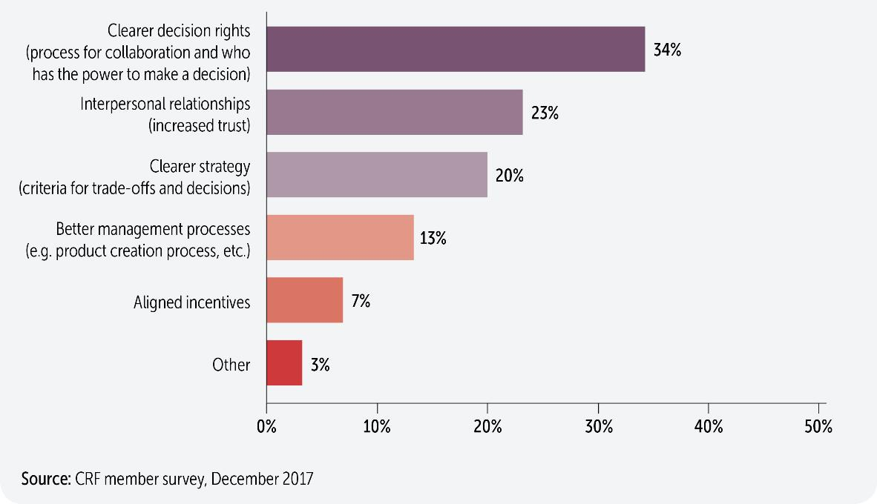
Q4: With regard to networks – working across boundaries to tie the organisation together – what do you believe would have the greatest impact on improving the effectiveness of your organisation?

Slide 7
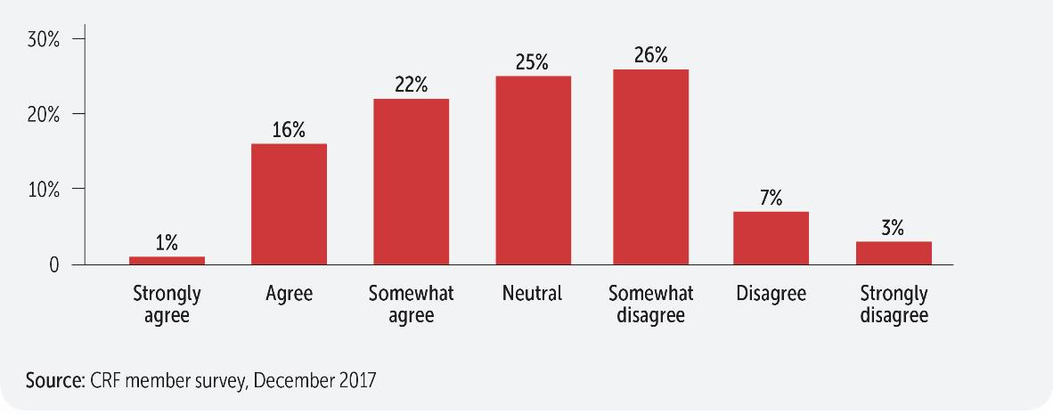
Q5: Our global and local teams work well together to come up with the best growth initiatives for the company. They collaborate well around a common agenda without worrying about who is in charge.

Slide 8
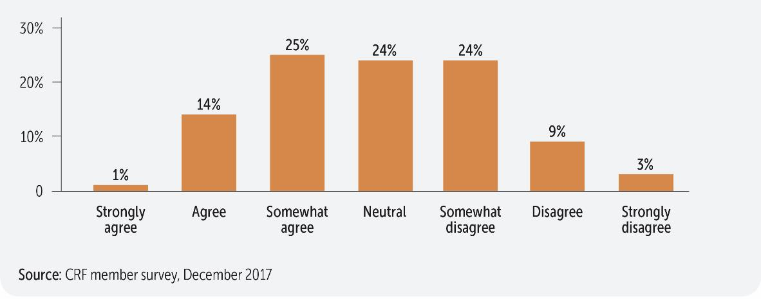
Q6: New product and other growth initiatives can come from anywhere in the organisation and we have a process to scale them and lift and shift ideas to other parts of the company.

Slide 9
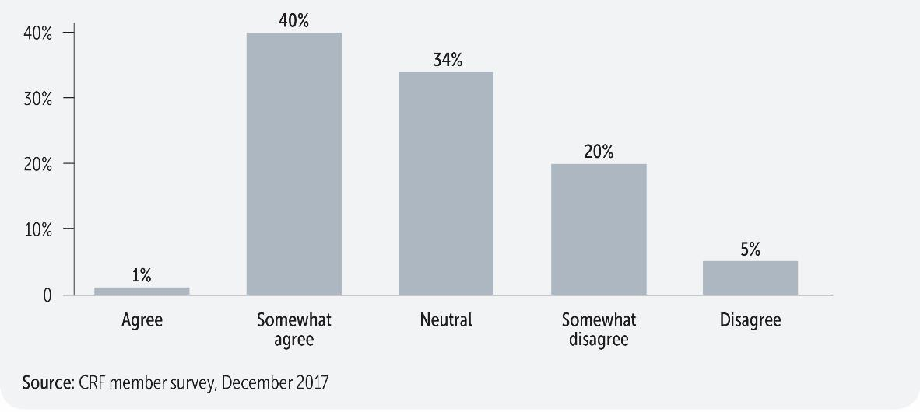
Q7: We are able to implement systems, processes, and practices that create efficiency and value for our customers across operating units.

Slide 10
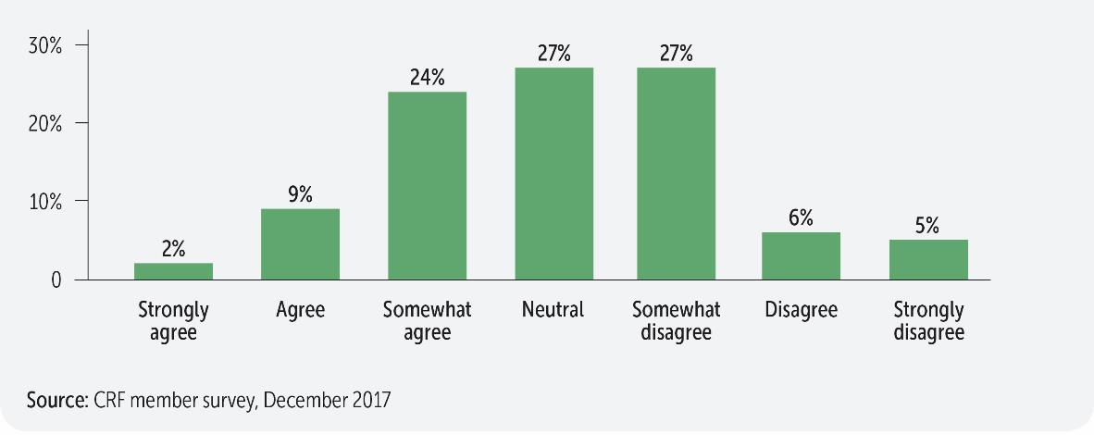
Q8: We are effective at scaling capabilities that sit in a region or business unit to benefit the entire company (e.g. a product development centre in a remote location).

Slide 11
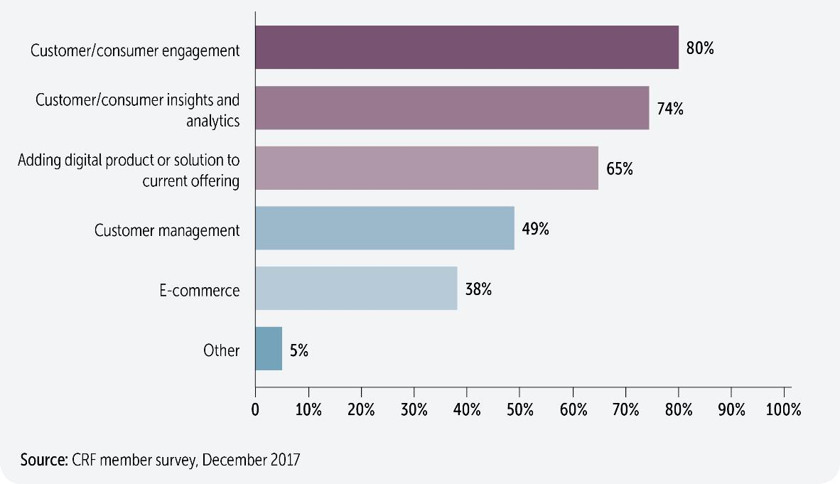
Q9: Our digital capabilities include…

Slide 12
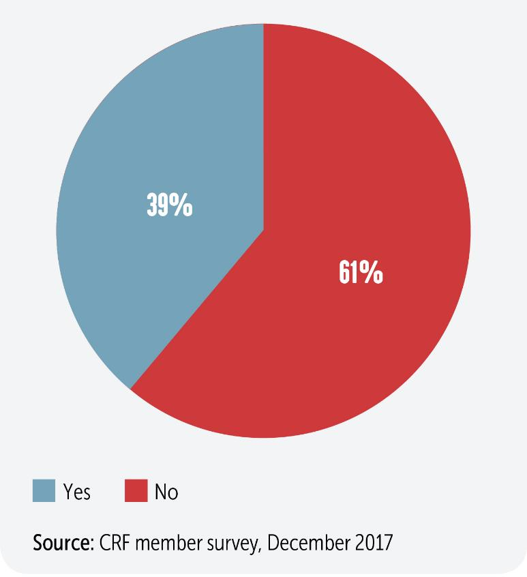
Q10: We have a Chief Digital Officer for the company.

Slide 13
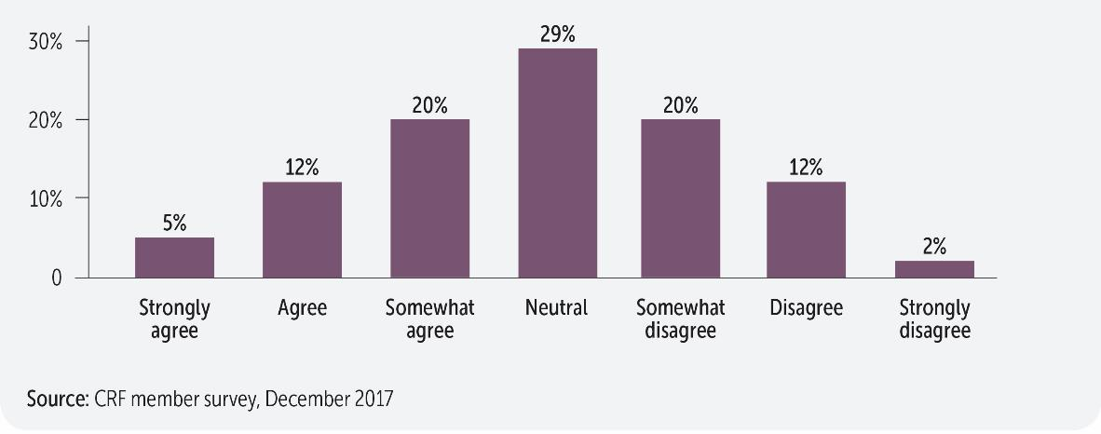
Q11: Our digital strategy for the company is clear.

Slide 14
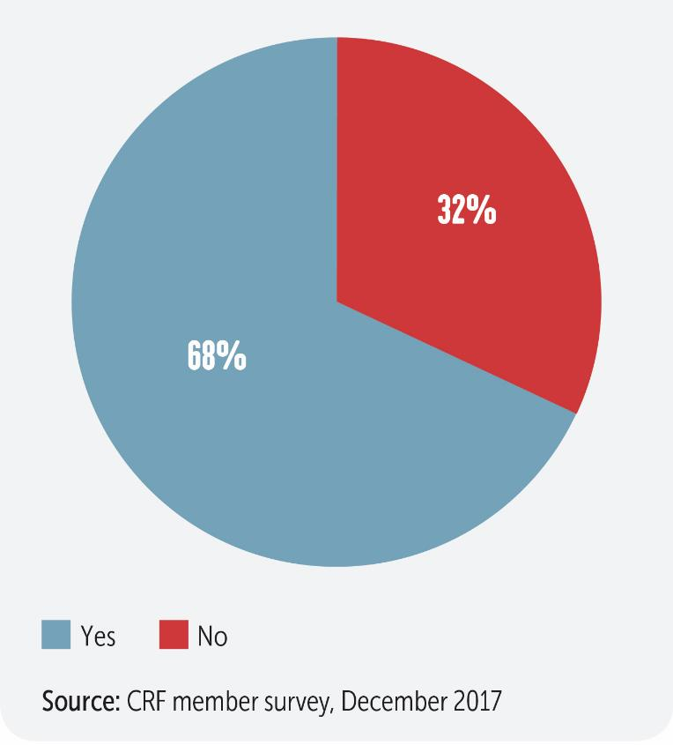
Q12: We are feeling confident we are on the right track with our evolving digital organisation model.

Slide 15
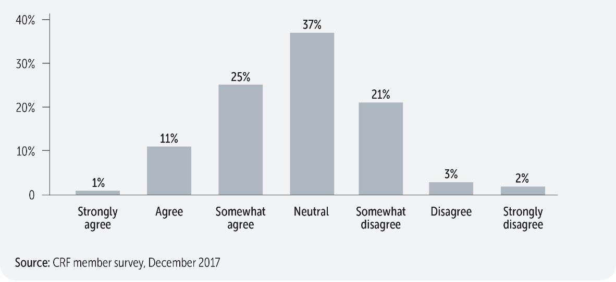
Q13: We are managing the tensions between our future business model (i.e. digital solutions) and our legacy business model pretty well.

Slide 16
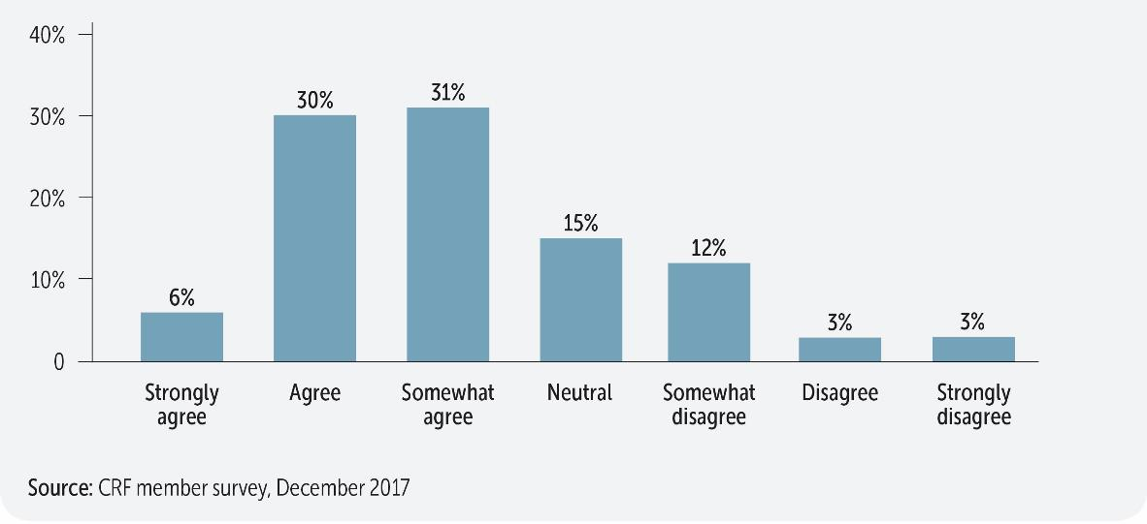
Q14: Finding the right way to organise the digital components of our organisation is a top priority for us right now.

Slide 17
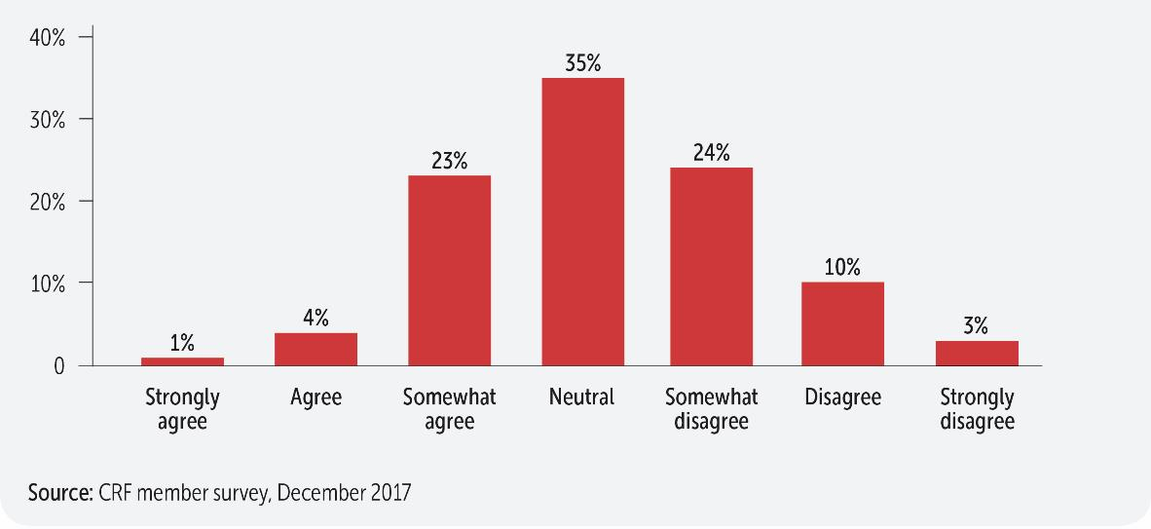
Q15: Our current digital organisational model is effective.

Slide 18
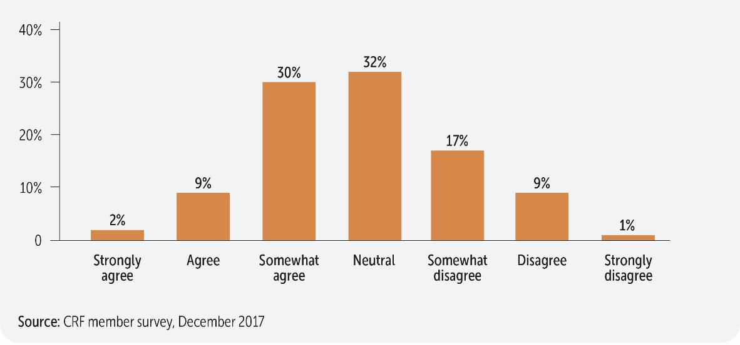
Q16: Our digital teams are working well with the more traditional parts of our business where those connections are important (e.g. with marketing, selling, product management, etc.).

Slide 19
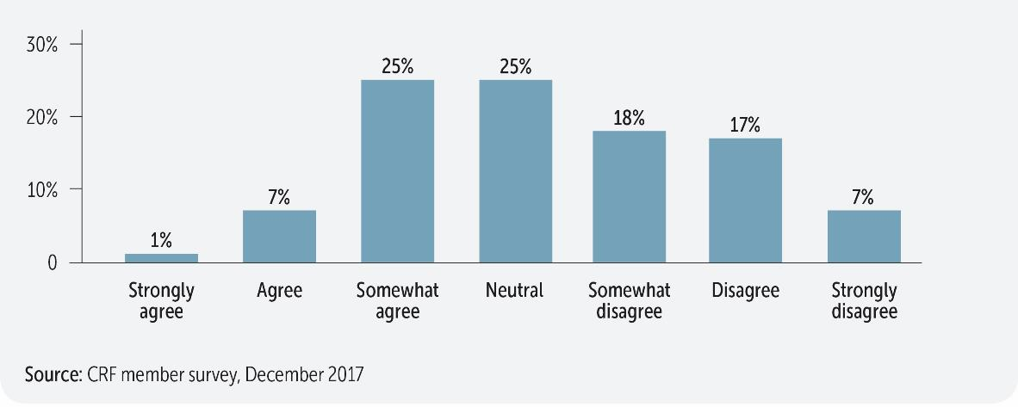
Q17: Our digital and HR teams have a strong relationship that is at the heart of our organisational transformation.

Slide 20
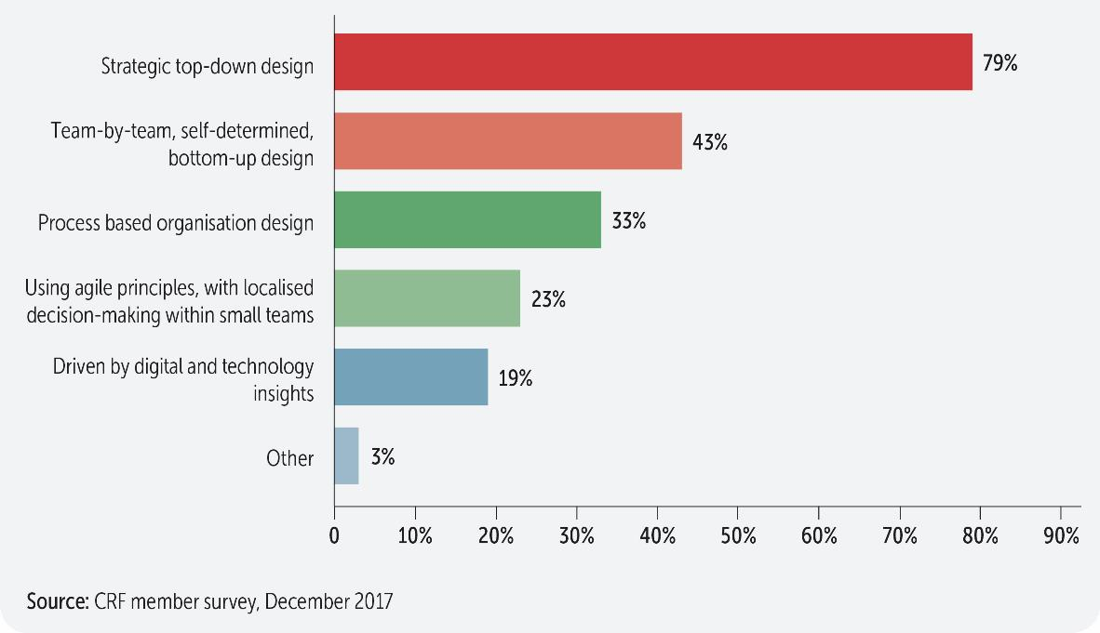
Q18: How does your organisation approach organisation design initiatives?
Choose all that apply.

Slide 21
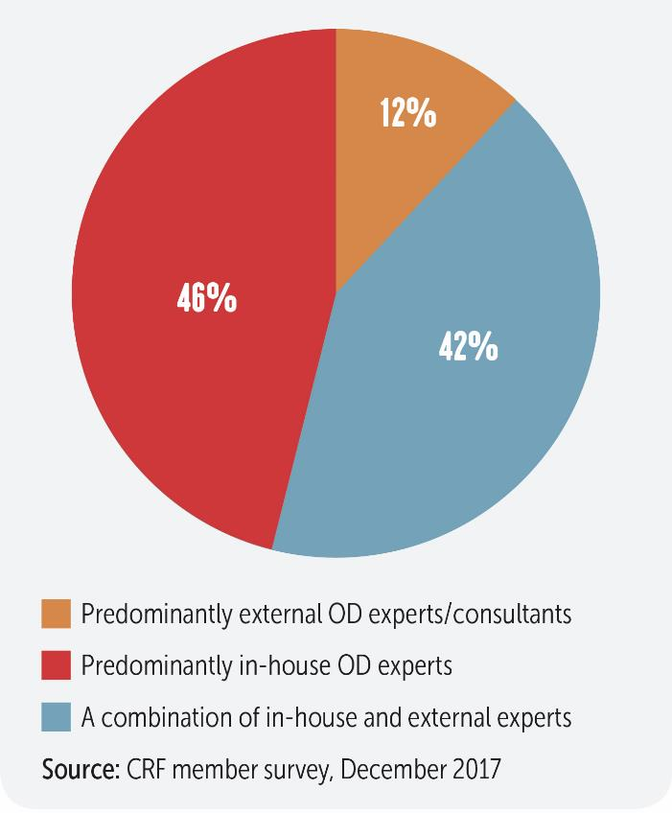
Q19: Who typically takes the lead in developing organisation design options/solutions?

Slide 22
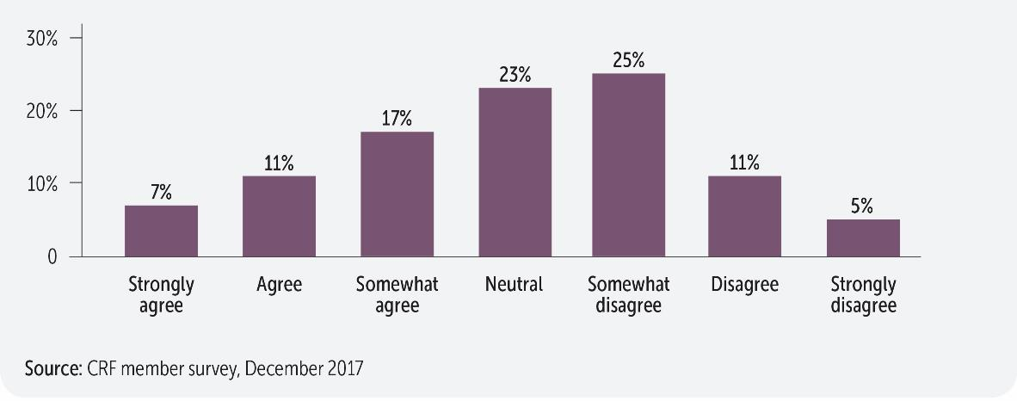
Q20: We use data and analytics extensively in our organisation design initiatives.

Slide 23
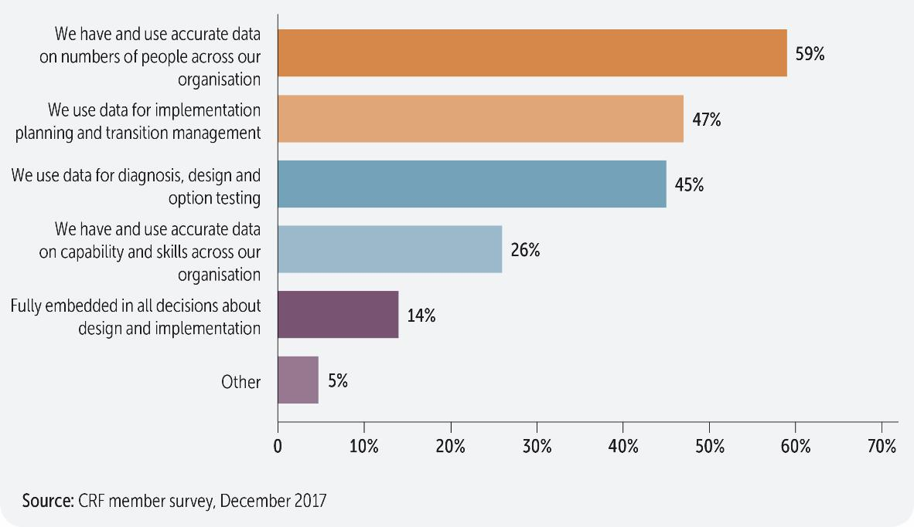
Q21: How does data and analytics contribute to your organisation design initiatives?
Choose all that apply.

Slide 24
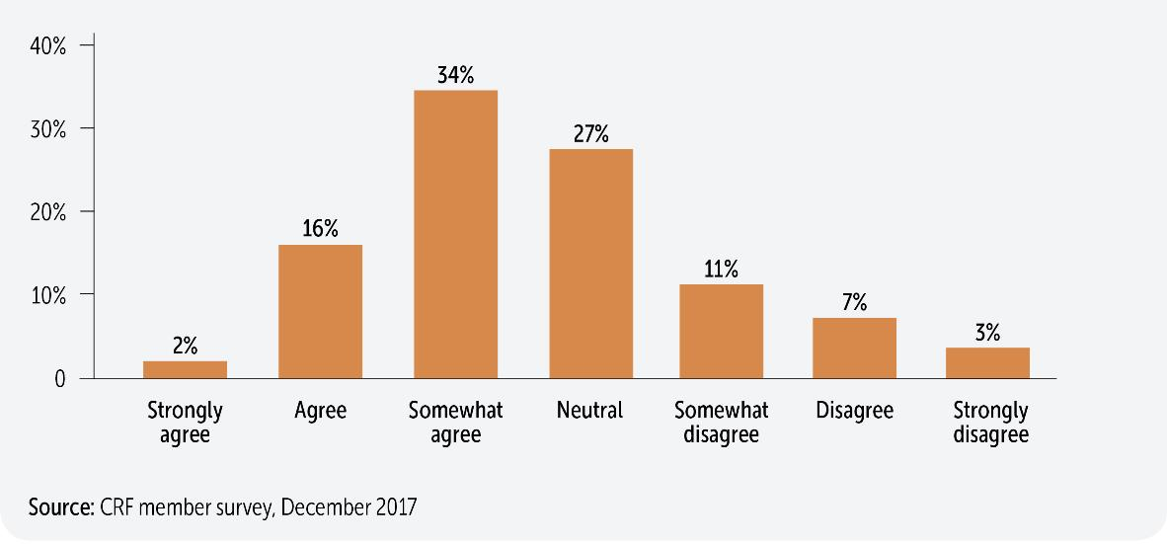
Q22: Our business leaders believe that our HR organisation is prepared to support them to solve organisation design issues.

Slide 25

Q23: We have strong organisation design capability within HR.

Slide 26
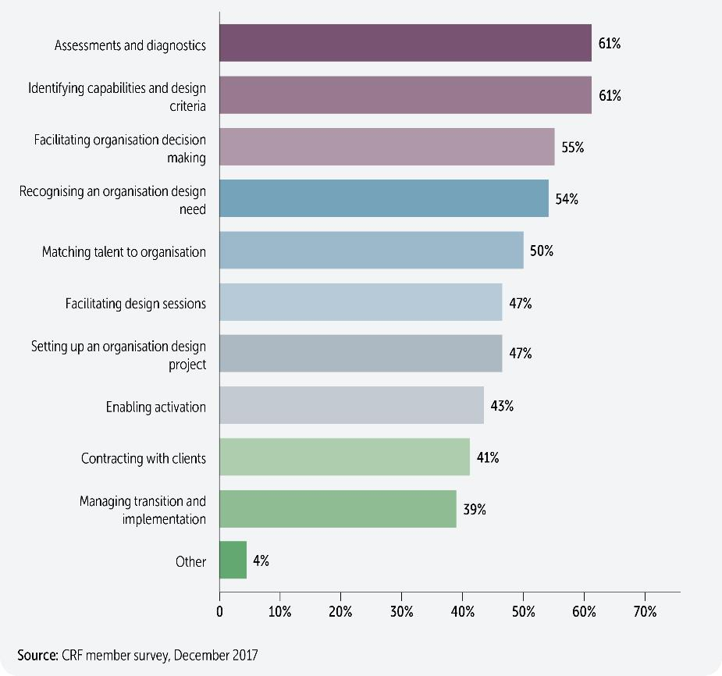
Q24: We need to strengthen our organisation design capability for HR in the following areas.

Slide 27
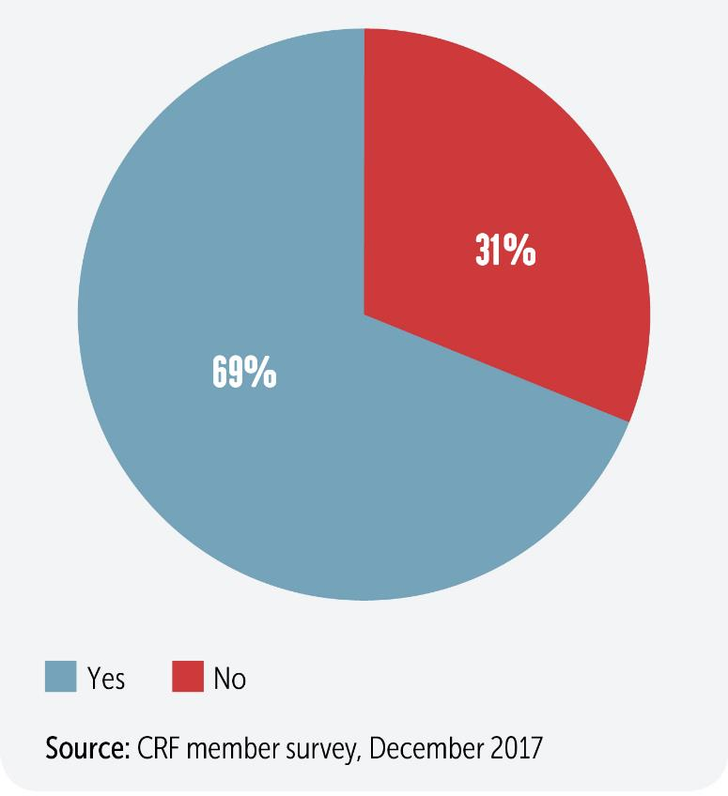
Q25: Has your HR function gone through a significant restructure over the last three years, or is one currently ongoing?

Slide 28
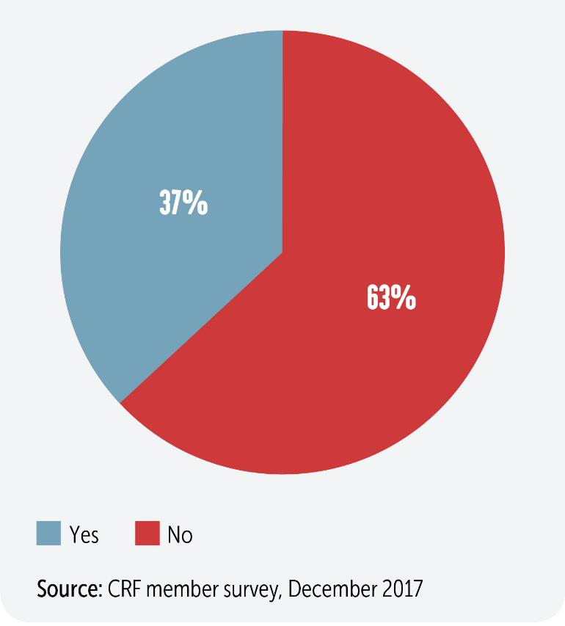
Q26: Is there a plan to significantly restructure the HR function over the next two years?

Slide 29
Conclusions
The environment for organisations today is characterised by complexity, rapid change, and digital disruption. To remain competitive in this context, organisations must meet the key organisation design challenge of balancing agility and scale.
Organisation design is a highly complex and technical subject, requiring a deep understanding of business strategy, process, relationships, structure, and people.
Organisations are adaptable systems, not machines, and need to be designed as such. The design of networks, relationships, and the interfaces between different parts of the organisation requires the same careful attention as the design of structures, hierarchies, and decision rights.
Organisation design has the potential to be a source of competitive advantage, but it is an underdeveloped capability in HR. Most organisations would benefit from investing in their capability in this area.

Slide 30
Appendix: Research Method
This report is based on the following sources of data:
Interviews with 23 practitioners, experts, and academics;
An online CRF survey completed by 164 respondents in November-December 2017. Respondents were predominantly senior HR generalists and OD specialists who ranged across different industries. 58% worked for organisations with 10,000 employees or more. 60% were UK based, the remainder were mainly from Europe and North America;
An extensive literature review of key academic and practitioner studies, books and articles.
This PowerPoint is extracted from CRF’s 2018 research report ‘Designing Adaptable Organisations for Tomorrow’s Challenges.’ For more information email gillian@crforum.co.uk or go to www.crforum.co.uk

Slide 31
Corporate Research Forum
Southside | 105 Victoria Street
London | SW1E 6QT
Tel: +44 (0) 203 457 2640
www.crforum.co.uk | @C_R_Forum
Thank you

