Slide 1
Digital Disruption – Exploring the implications for
leaders and leadership development
London 3 April, Lausanne 5 March
Jay Conger and Gillian Pillans

Slide 2
Notes:
$400 bn – estimated size of global HR tech market (who said people didn’t spend money on HR?)
26 million – the number of companies using LinkedIn – reaching out to 590 million members…..
57% - percentage of CRF members using or experimenting with new technologies in talent acquisition like chatbots, advanced analytics, gamification, etc)
43% of CRF members lacked confidence in their HR data
34% of CRF members were dissatisfied or very dissatisfied with their recruitment technology
Fewer than 20% of companies give employees access to mobile HR apps (source – Deloitte 2016)

Slide 3
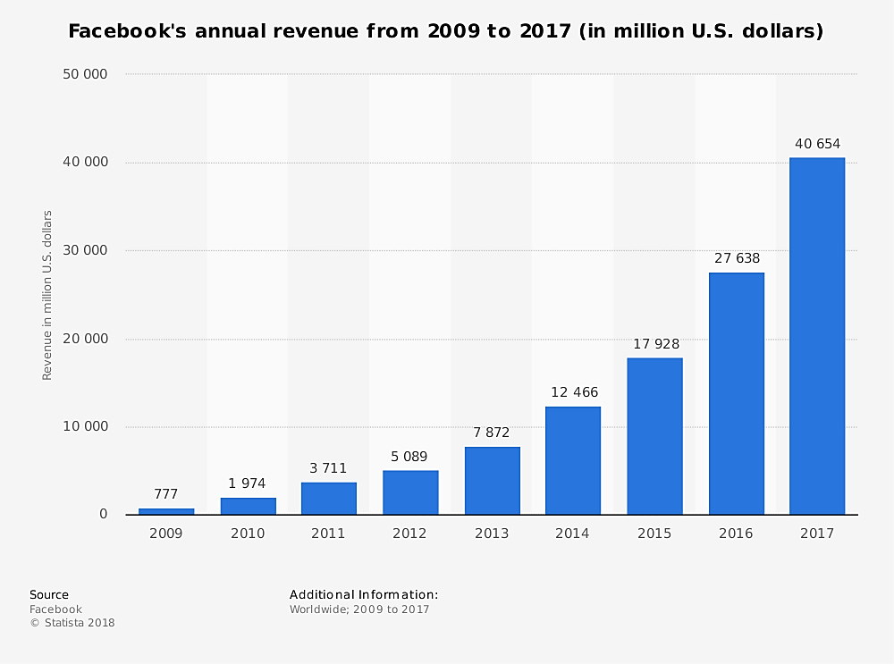

Slide 4
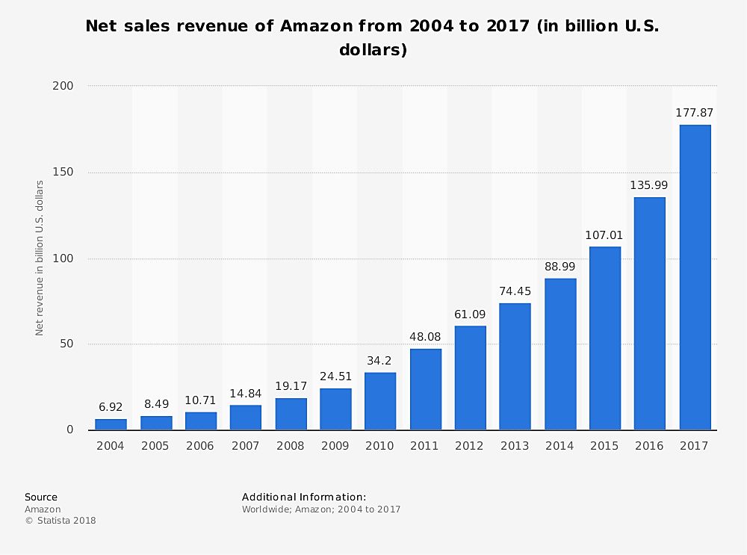

Slide 5
Business model blow-outs

Slide 8
Notes:
Thank all the respondents to the survey and the survey sponsors, KPMG and SD Worx as well as all those who contributed to the report such as interviewees, writers, etc

Slide 10
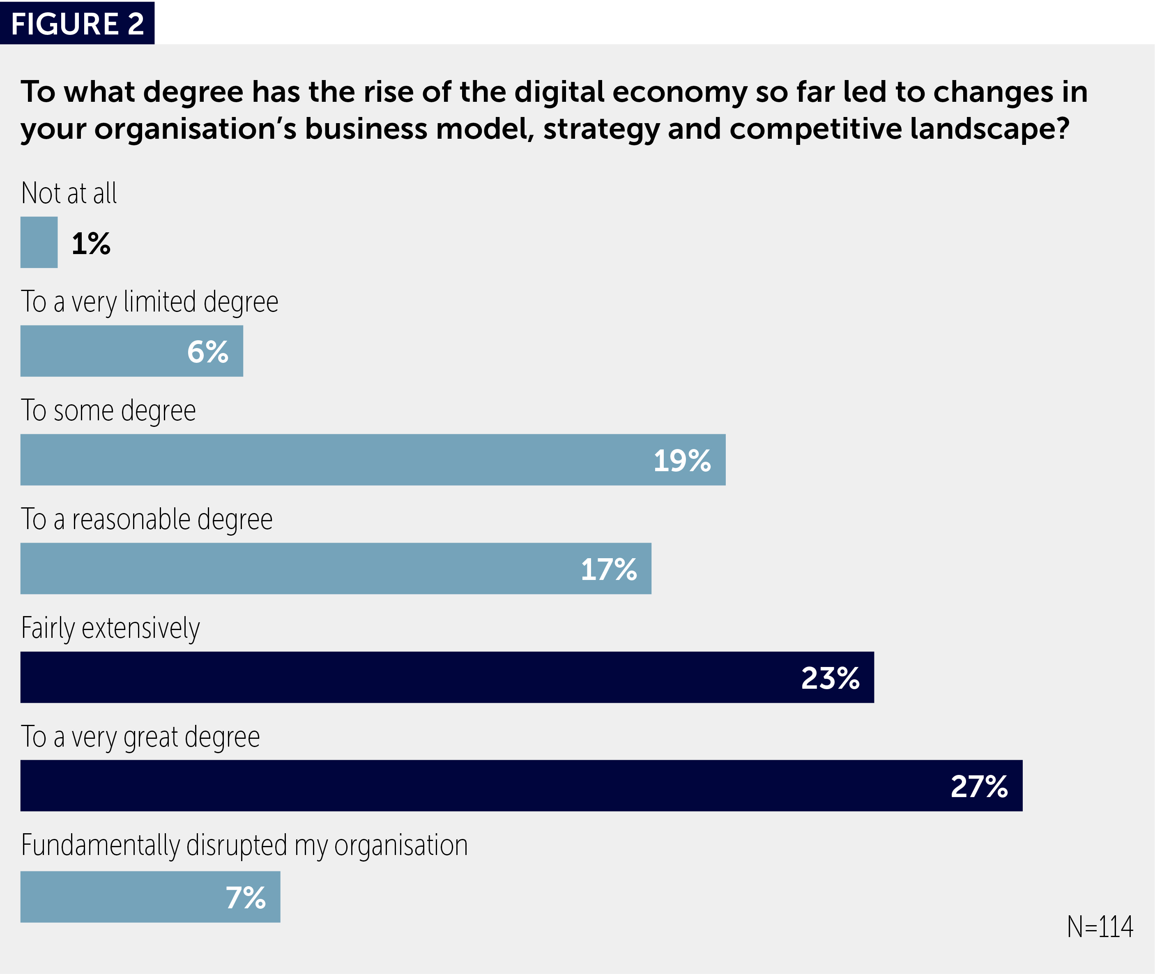

Slide 11
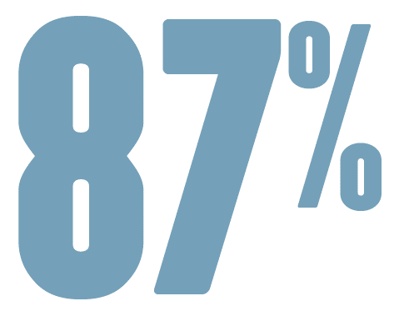
anticipate the
digital economy will fundamentally or fairly extensively disrupt their industry in the future

Slide 12
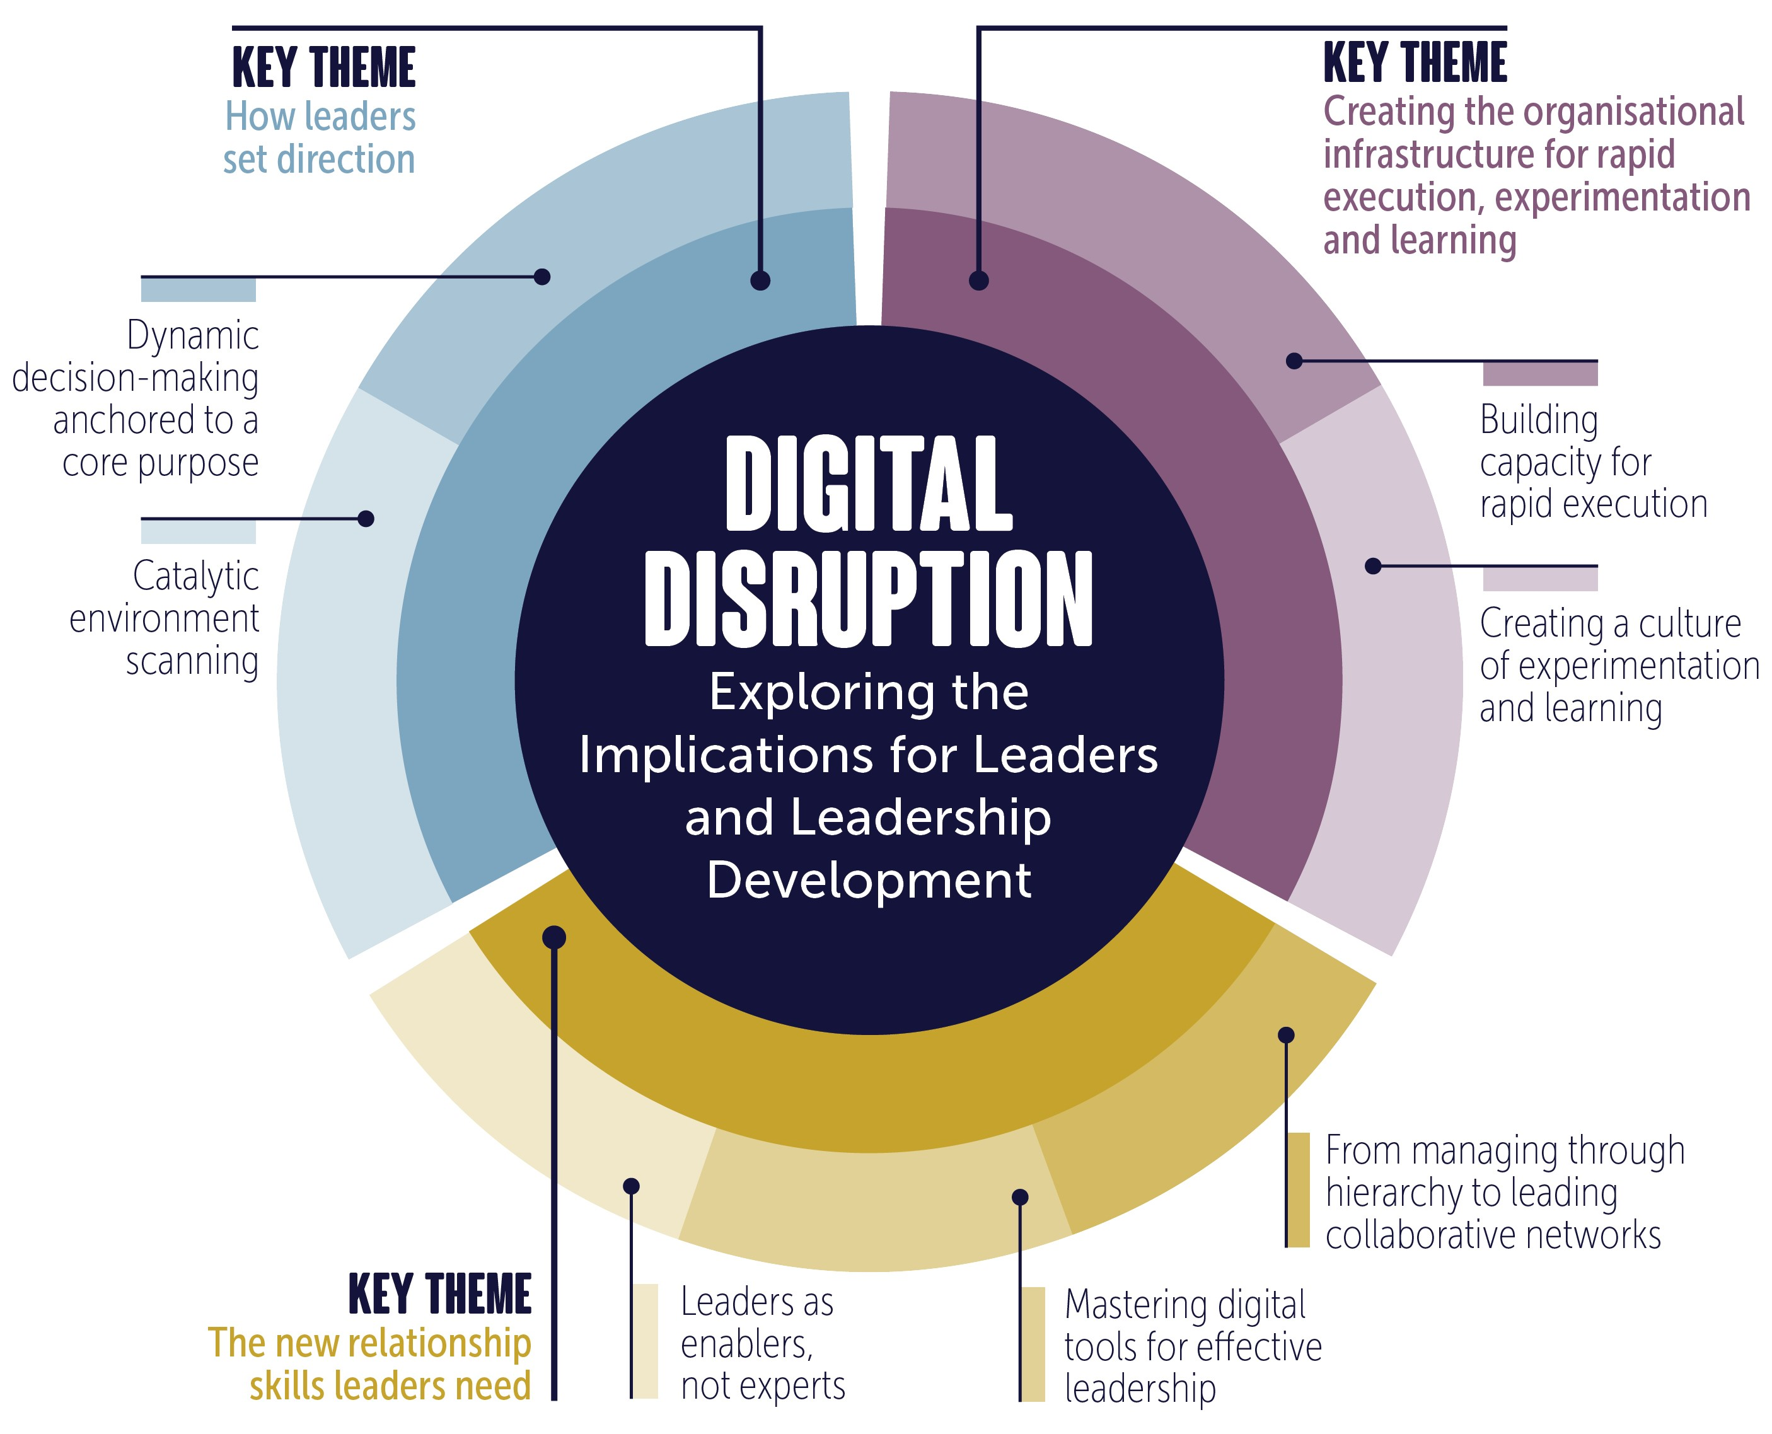

Slide 13
Procedural versus Declarative

Slide 14
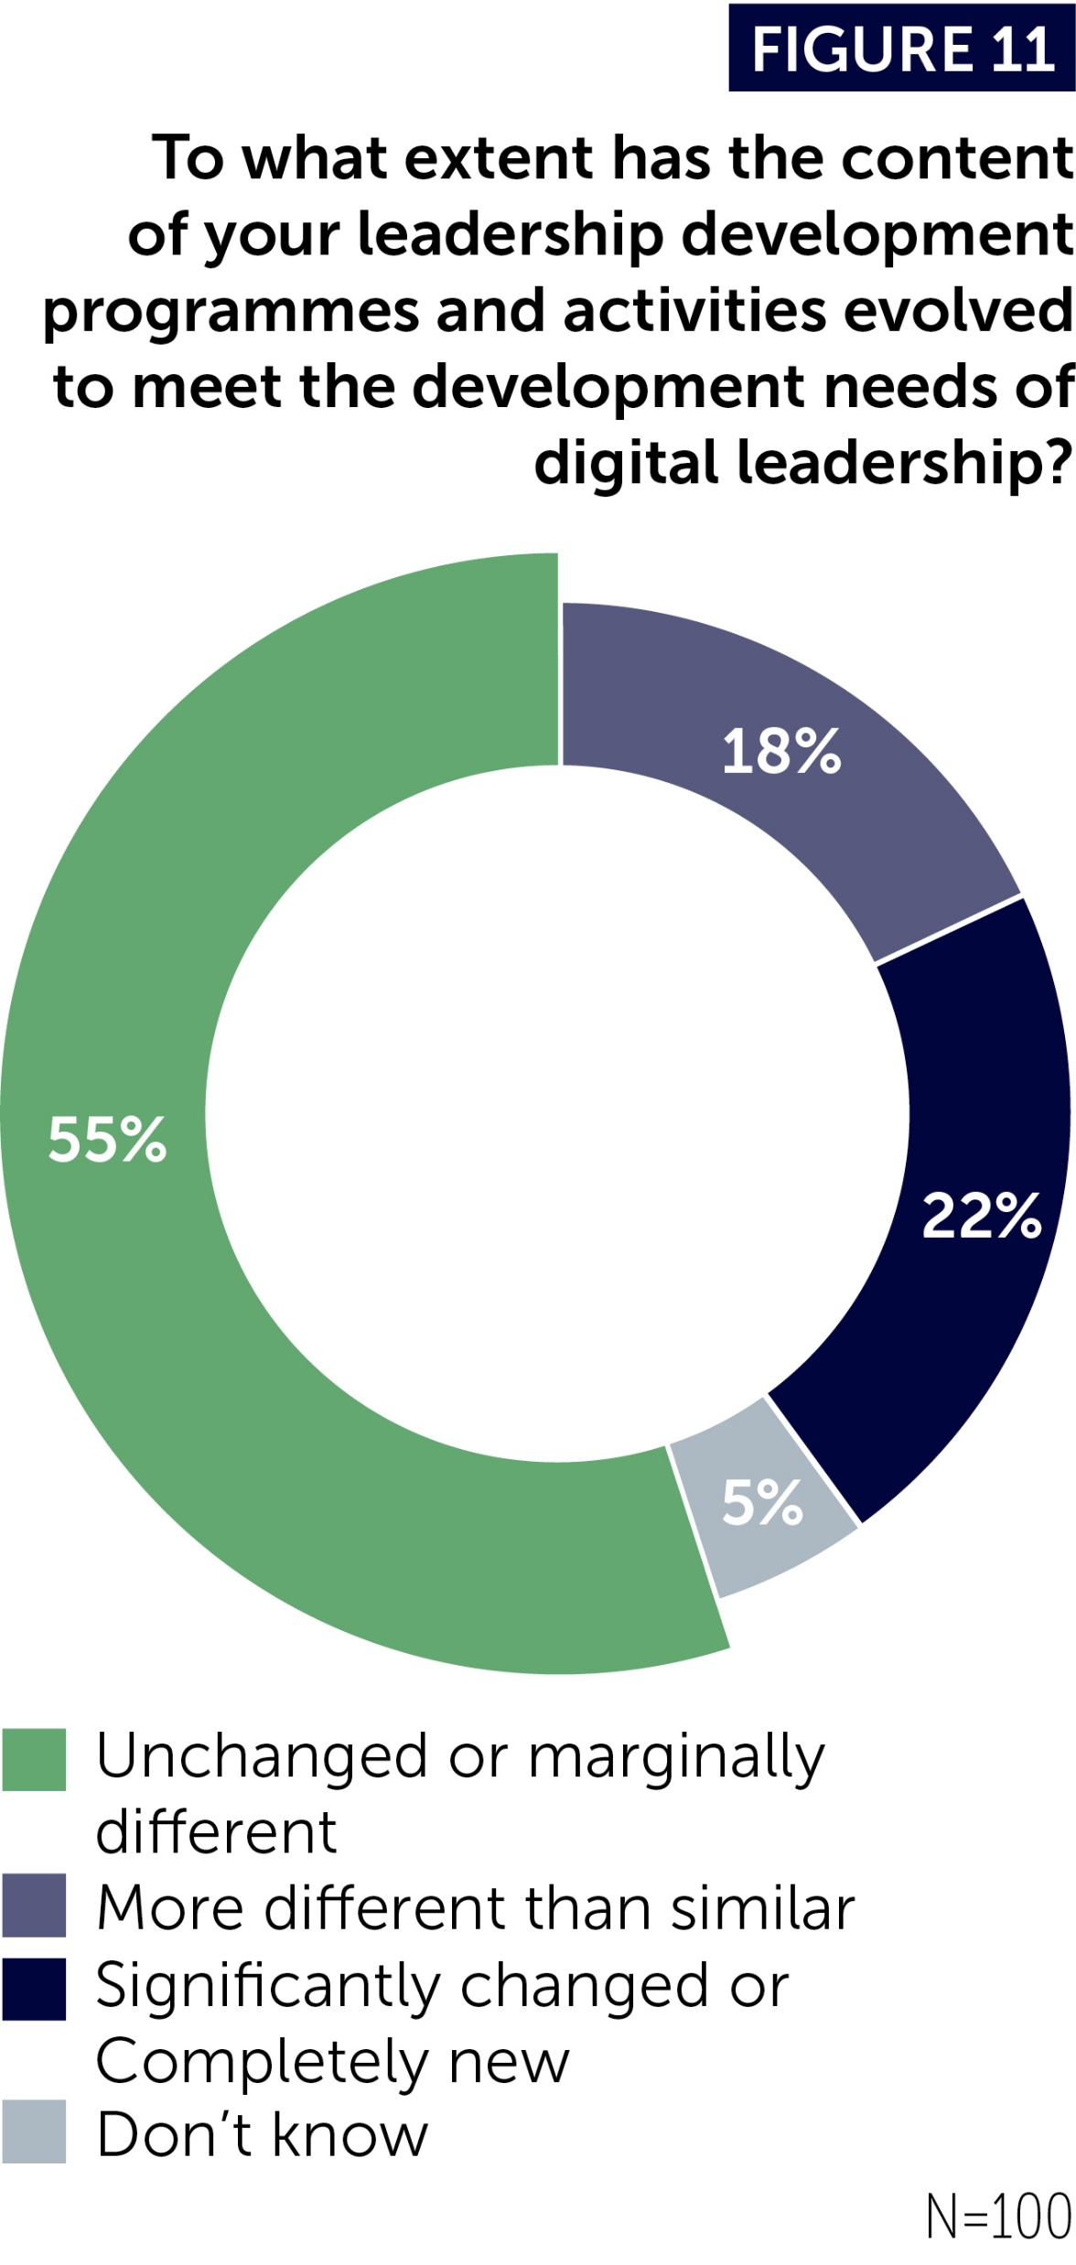
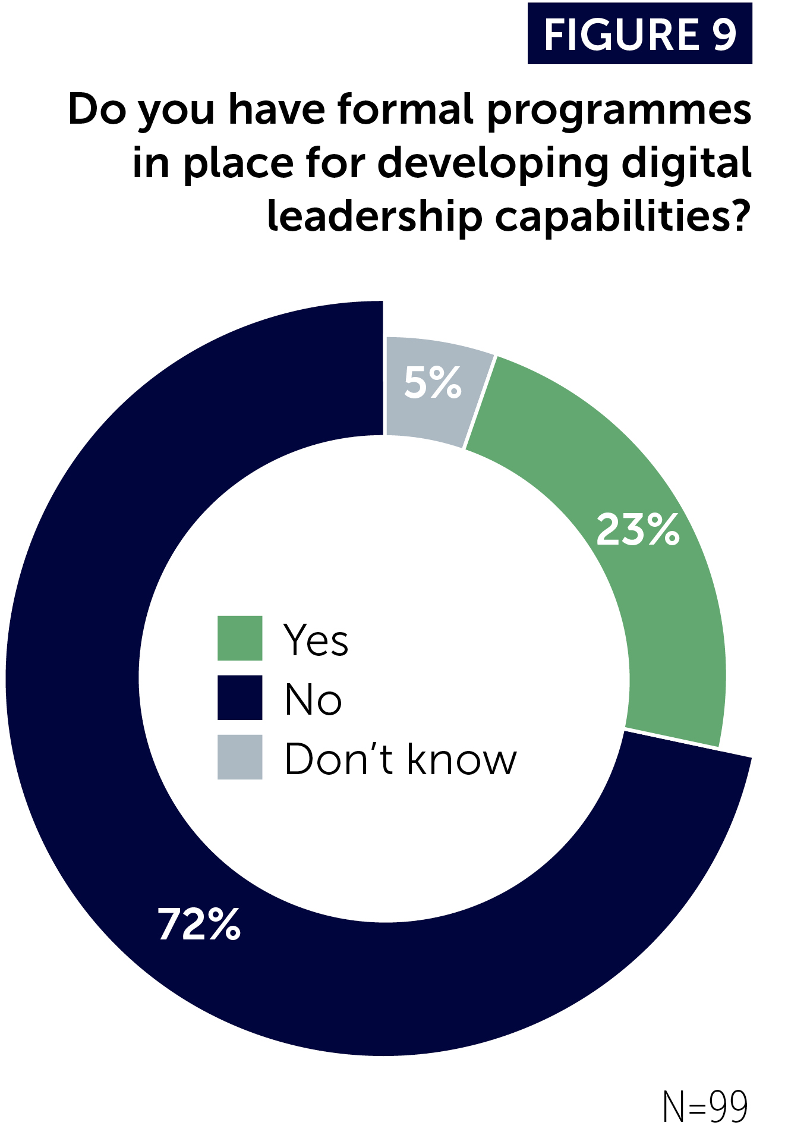

Slide 15
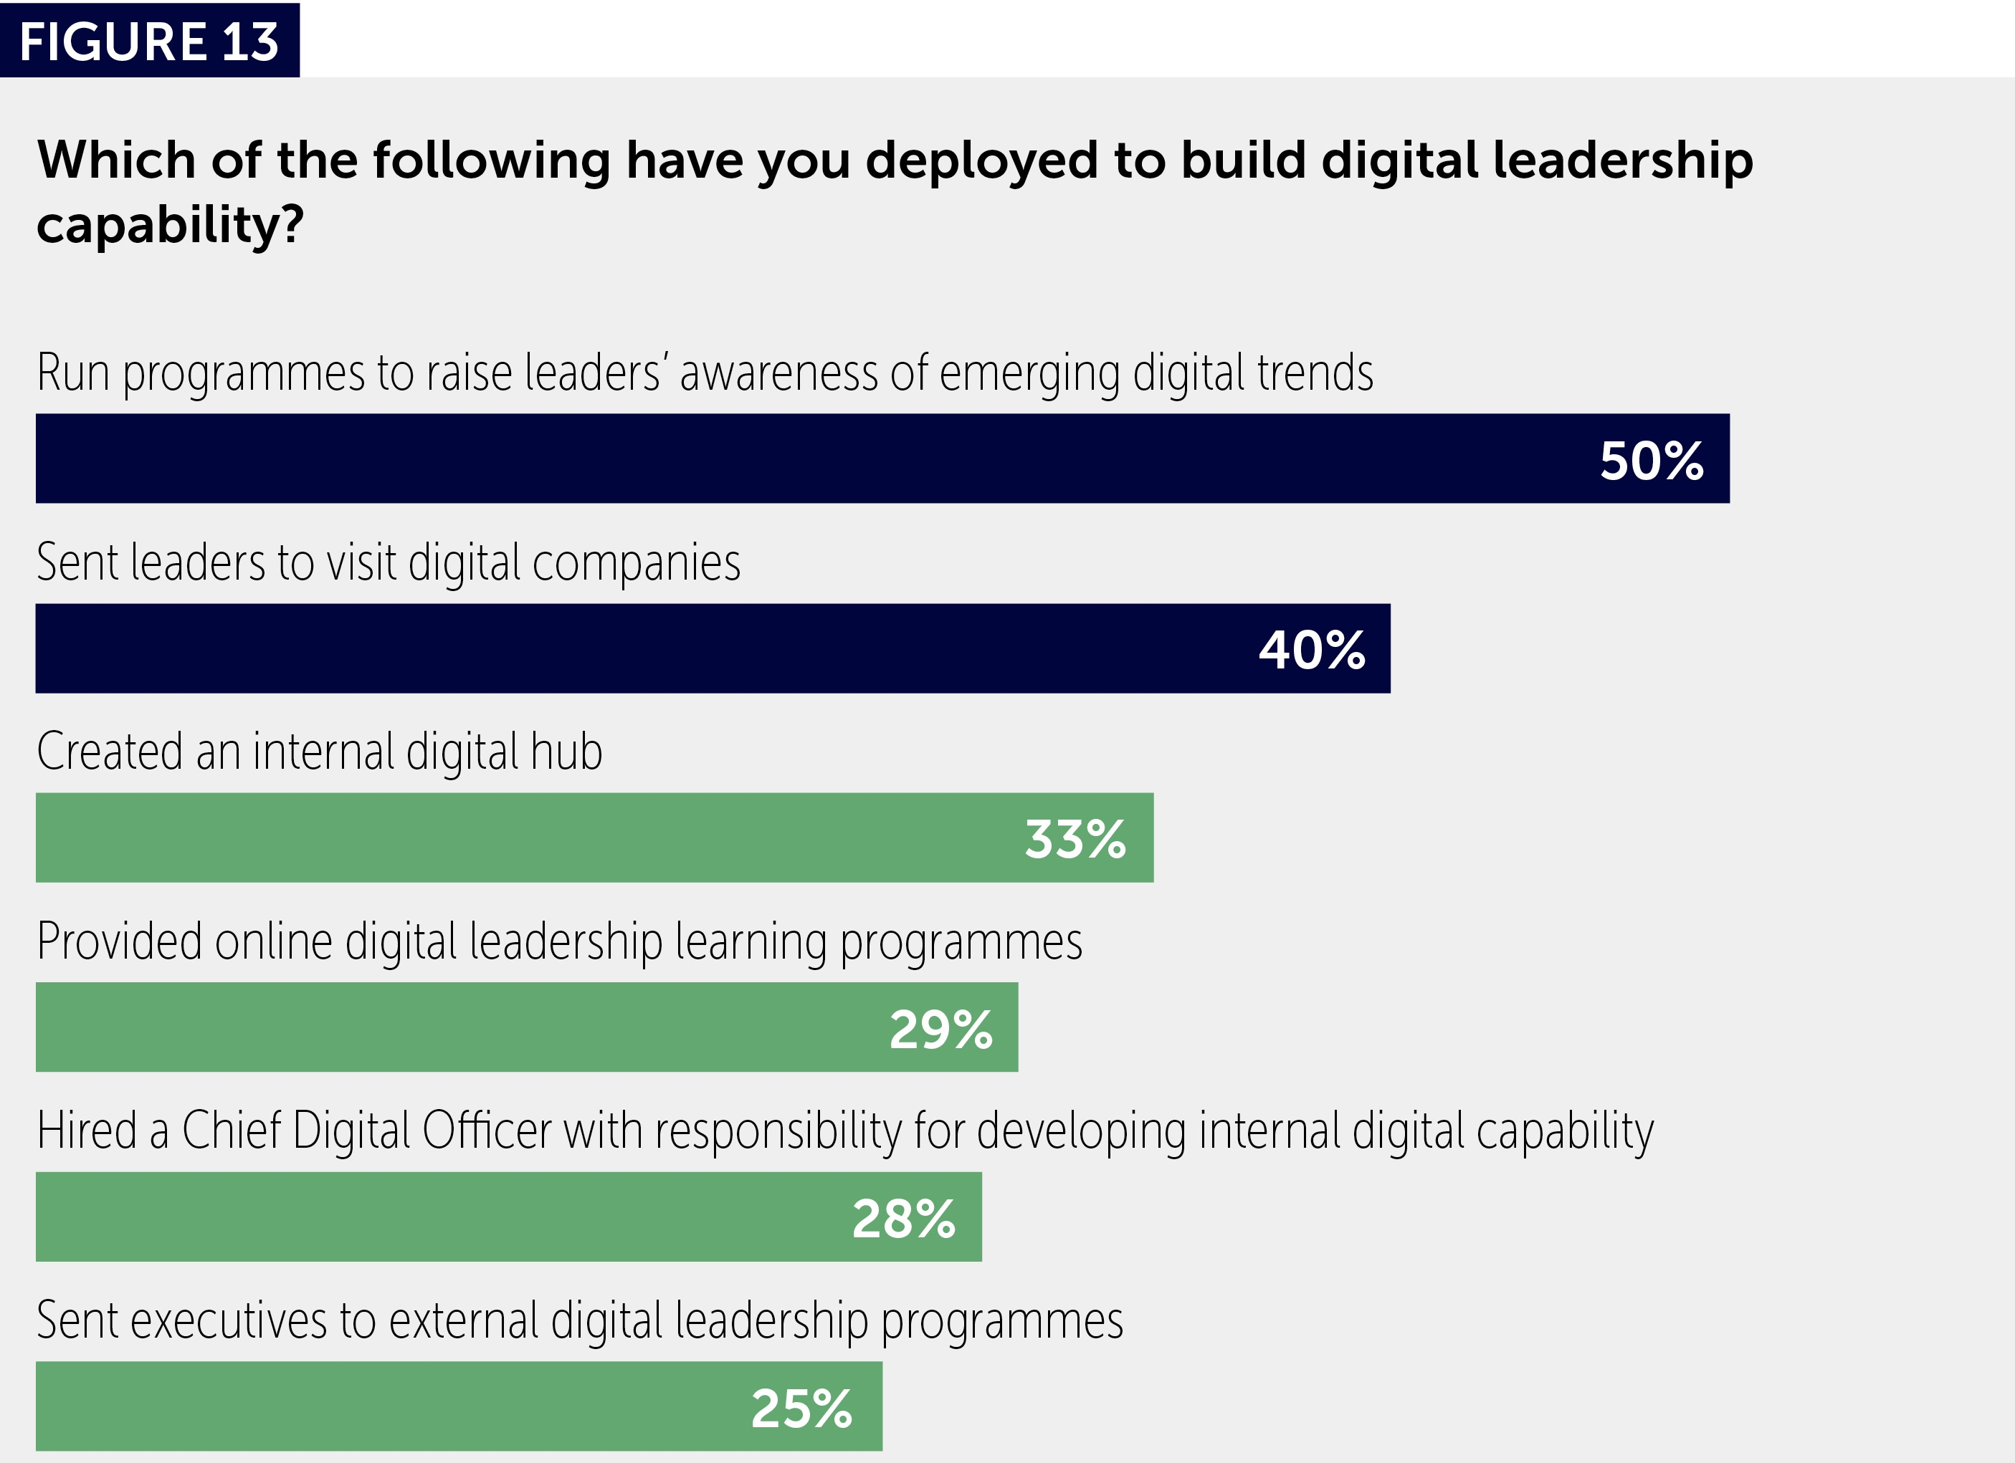
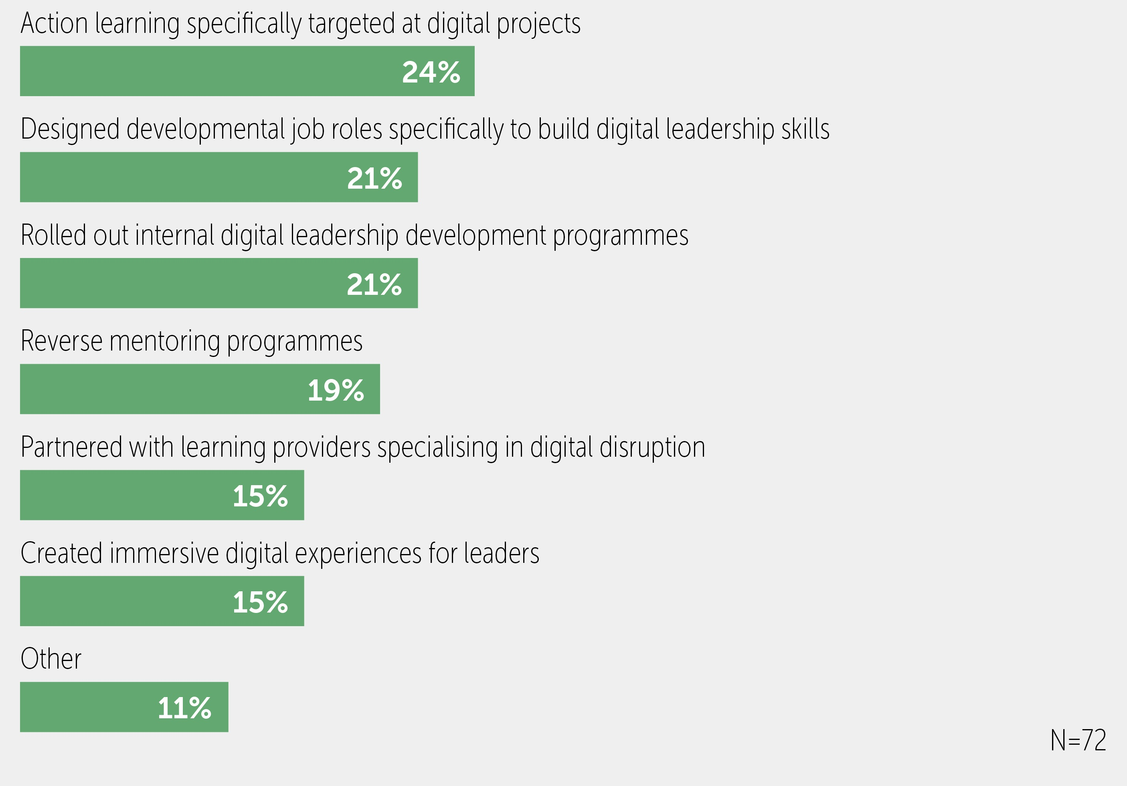

Slide 16
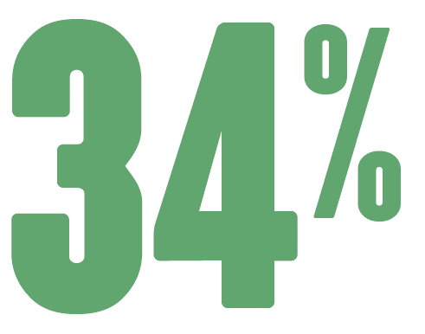
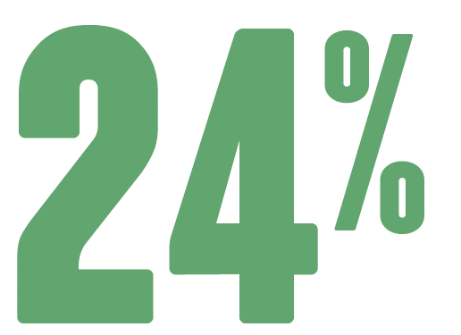
don’t know if their digital leadership initiatives are effective
were judged unsuccessful

Slide 17
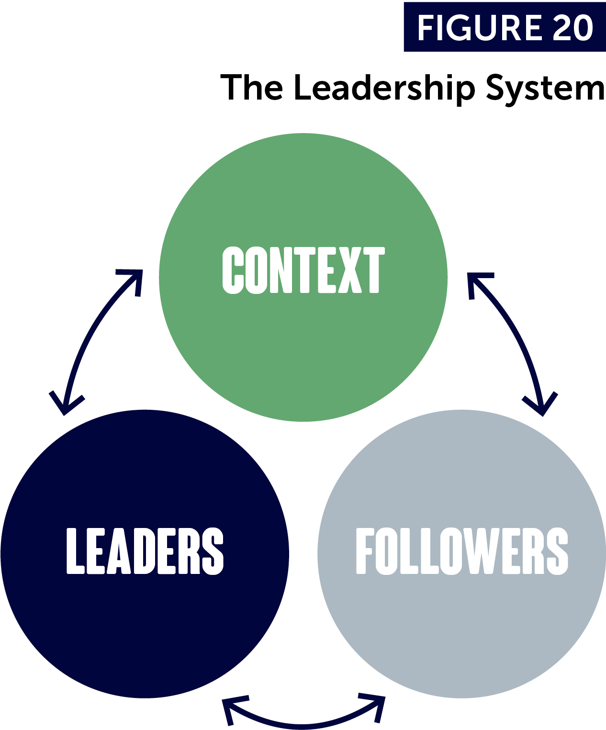

Slide 18
Group discussions

Slide 19
Group discussions
Do you feel that leadership in an age of digital disruption is more hype than reality or more reality than hype?
If the latter, how is the digital age directly influencing the expectations of leaders in your organisation?

Slide 20
Group discussions
What’s your conclusion: is digital leadership more substance than hype or more hype than substance?
What is your personal takeaway or insight from this session?
What is one action you plan to take as a result?

Slide 21
Closing thoughts…

Slide 22
What worries me the most…
All the Potemkin Villages that will be built.

Slide 24
The pyramid and the pod will co-exist…
Where do you need the pods… the digital leadership?
Put your best people in charge of the future… versus the core.
What are the new metrics?
What are the rewards… are they enough?
How will you develop the demanded skills – beware of procedural traps?

Slide 25
If I could select one capability…
It would be catalytic learning.

Slide 26
If I could develop one skill…
It would be facilitation.

Slide 27
If I could develop a few others…
They would include navigating decision traps, scenario planning, shared and entrepreneurial leadership.

Slide 28
If I could use only one methodology…
It would be action learning with lots of anchors.

Slide 29
“Adapt or perish, now as ever, is nature’s inexorable imperative.”
H. G. Wells

