Slide 1
Behaviour change in organisations
Research briefing deck
October 2025

Slide 2
HR helps the business achieve its objectives by shaping employee behaviour
Broad HR practices often target vague outcomes
Targeted behaviour change focuses on specific, measurable and observable actions
These links from behaviour to results are clear and evidence based
“Behaviour
IS business.
All organisational results are the product of human behaviour.”
Daniels & Bailey (2014)
Notes:
Every organisational result, good or bad, comes down to human behaviour.
The purpose of HR is to help the business meet its objectives by shaping and changing employee behaviour so that what people do every day is aligned with what the organisation needs to achieve.
HR often tries to influence behaviour through broad practices such as compensation, wellbeing programmes or learning and development.
These are valuable but they tend to target quite general or vague ideas like engagement or loyalty.
This makes it difficult to see whether they actually lead to measurable improvements in performance.
In contrast, there are times when HR needs to deliberately change specific behaviours, such as how salespeople approach clients or how frontline staff interact with customers.
These behaviours have a clear line of sight to organisational results.
By focusing on specific, observable and measurable behaviours, it becomes much easier to design interventions that work and to evaluate whether they have made a difference.

Slide 3
Examples of strategic objectives and target behaviours
Strategic Objective | Target of Behaviour Change Intervention
Developing new products Improving quality Retaining customers Increasing revenue | Behaviours around innovation Error reduction behaviours Behaviours related to resolving customer queries Sales-closing behaviours
Notes:
To change behaviour effectively, HR first needs a clear understanding of the organisation’s strategic objectives.
Once those are defined, we can identify which employee behaviours contribute most directly to achieving them.
This table gives some general examples.
For instance, if the goal is to develop new products, we might focus on innovation behaviours such as idea generation, collaboration, knowledge sharing and championing ideas.
The key point is that behaviour change should always have a clear purpose: to help the business achieve its objectives.
Even when the desired behaviours are clear, whether those changes actually improve outcomes will depend on the wider organisational context.
Factors such as systems, leadership and environment all play a part.

Slide 4
What is behaviour and what is not behaviour?
What is behaviour? | What is not behaviour?
Observable, measurable and active (e.g., physically doing something, saying something) Conscious thoughts and feelings (as these are observable and measurable to the person) that occur at particular moments, although some definitions of behaviour exclude such internal and private phenomena. | Outcomes and results of behaviour Attitudes (e.g., satisfaction, engagement, commitment) States (behaviours may result in states but are not states) Values (e.g., moral or work-related) Activities and tasks General vague categories of behaviour (e.g., teamwork, enthusiasm, communication, delegating, being proactive)
Notes:
This table helps clarify what we mean by behaviour, which is essential if we want to change it.
Behaviour is something observable, measurable and active, such as physically doing something or saying something.
What does not count as behaviour are things like outcomes, attitudes or states.
These are the results of behaviour, not the behaviours themselves.
The same applies to values or general categories such as teamwork or being proactive, which are too vague to observe or measure.
For behaviour change to be effective, the behaviours we target must be specific, observable and measurable.
If we cannot see or measure them, we cannot provide feedback, track change or evaluate impact.
This precision allows HR and managers to identify which actions drive business outcomes and to design interventions that actually change them.

Slide 5
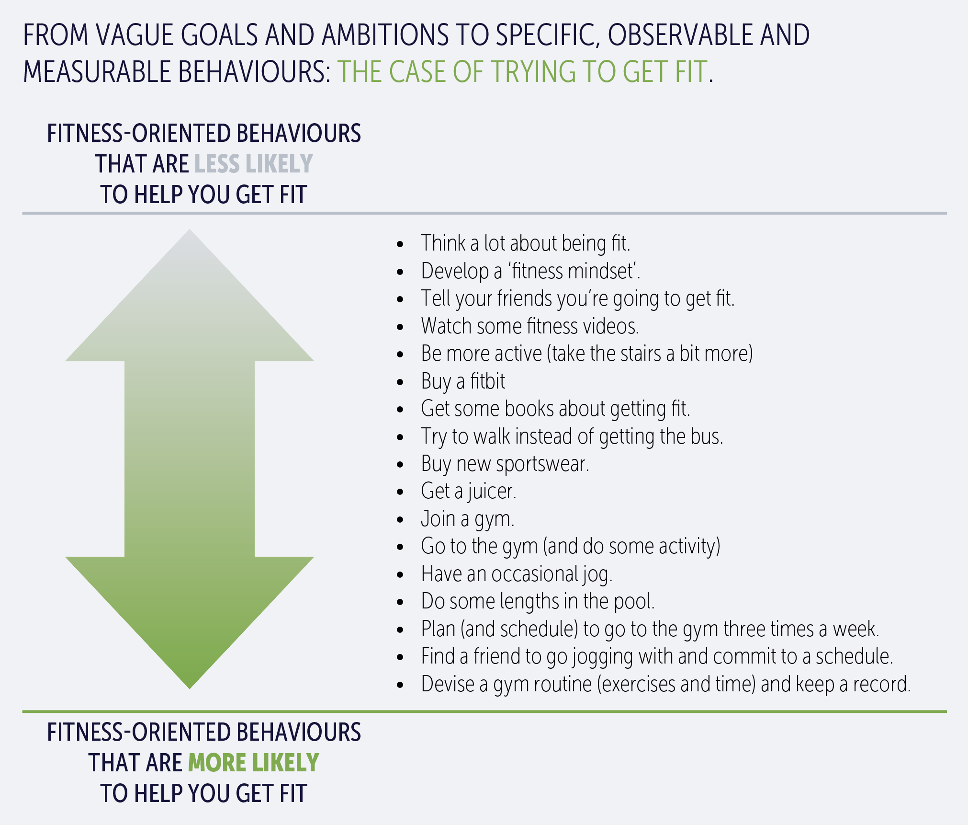
The importance of observable and measurable behaviour
Notes:
This example illustrates why being specific about behaviour is so important.
When we talk about getting fit, it sounds clear, but it is actually vague.
It is an outcome, not a behaviour.
Achieving that outcome depends on a series of specific, observable actions that we can see, measure and repeat.
As the figure shows, many of the things we might do in the hope of getting fit, such as buying sportswear or thinking about exercising, do not necessarily help us achieve that goal.
They feel productive but they are not the behaviours that lead to measurable change.
The actions toward the bottom of the figure, such as planning workouts, keeping a record, going to the gym regularly or exercising with a partner, are examples of specific behaviours that are far more likely to produce the desired outcome.
The same principle applies in organisations.
If we want to change performance or achieve a goal, we need to identify and target the specific measurable behaviours that actually drive results, not just broad intentions or attitudes.

Slide 6

Identifying important employee behaviours
Through a process known as pinpointing within organisational behaviour management, we may discover that there are three key staff behaviours which strongly shape customers’ perceptions of staff approachability on the shop floor:
SUPERMARKET EXAMPLE TAKING ONE DRIVER:
Staff approachability.
1 | Making some eye contact with customers (so customers feel staff are aware of their presence).
2 | Smiling at customers (so customers feel staff are open to interaction and are taking an interest).
3 | Asking customers directly if they require help (so customers know they have an opportunity to ask questions).
Notes:
This example shows how we can identify and measure the specific behaviours that drive an important business outcome.
Imagine a supermarket chain with a strategic goal to improve the customer service experience in stores.
One of the factors that shapes this experience is how approachable staff seem on the shop floor.
To understand what approachability looks like in practice, we could start by reviewing customer service research or by talking directly to customers about what makes staff seem more or less approachable.
Using a process known as pinpointing, we might identify three observable behaviours that make the biggest difference to customer perceptions.
These are making eye contact, so customers feel noticed, smiling so they feel staff are open to interaction, and asking directly if they need help so they know they have an opportunity to ask questions.
Once identified, these behaviours can be measured and tracked.
We can establish a baseline and look for patterns across stores, staff or times of day.
This example shows how behaviour can be made precise and measurable, and how HR can connect day-to-day actions directly to strategic objectives.

Slide 7
Meanings and dynamics of behaviour change
Important to specific about what we mean by change and its dynamics.
>
Meanings of change
Introducing a new behaviour
Eliminating an existing behaviour
Reducing/increasing frequency of a behaviour
Reducing/increasing the intensity of a behaviour
Changing when a behaviour occurs
>
Speed of change
When change happens,
what next?
Stability
Still changing – but reducing
Still changing – but increasing
>
Notes:
When we talk about behaviour change, we need to be clear not just about what the behaviour is but about what we mean by change and how it unfolds over time.
Behaviour change can mean several different things.
It could mean introducing a new behaviour that does not currently exist, eliminating one that is unhelpful, or changing how often or how strongly a behaviour occurs.
It can also mean changing when a behaviour happens.
Each of these requires different kinds of action and support.
We also need to think about the speed of change.
Trying to change behaviour too quickly can create resistance, but changing too slowly can lose momentum or fail to show results.
The right pace depends on the behaviour, the context and the resources available.
Finally, we need to consider what happens after the change.
Sometimes the behaviour stabilises, which might be the goal.
In other cases, the behaviour might start to reduce or reverse, which could mean we need another intervention to sustain it.
Or it might keep increasing, which can be good up to a point but may become unhelpful if it goes too far.
Being clear about what kind of change we want, how quickly we want it to happen and what should happen next helps us design better interventions and monitor whether they are working as intended.

Slide 8
Why and how does behaviour change: Models and frameworks
Around 60-80 different theories and models.
No clear recommendations:
“Despite rapid growth in the empirical research on behaviour change, modern science has yet to produce a coherent set of recommendations for individuals and organisations eager to align everyday actions with enduringly valued goals.”
Duckworth & Gross (2020)
Should not rely or assume one particular approach or model is best.
Much depends on context.
Notes:
There are many different models and theories of behaviour change, around 60 to 80 by some counts.
These models often explain behaviour in different ways, using different factors and mechanisms.
You might expect that after decades of research there would be one clear and agreed model of how behaviour changes, but that is not the case.
Even with the rapid growth in research, science has not yet produced a single coherent set of recommendations for how to help people and organisations align their actions with their goals.
For HR and organisational practice, the key message is that there is no single model or framework that holds the answer to behaviour change.
We should be cautious of anyone who claims to have found one approach that always works.
Instead, context matters.
The most effective way to change behaviour depends on the specific behaviour we are trying to change, the people involved and the environment in which it happens.
In practice, HR professionals need to understand a range of models and use them flexibly, choosing the tools and frameworks that best fit the context rather than relying on one fixed approach.

Slide 9
To change behaviour do we need to tackle its root causes? No!
There are a huge range of potential ‘root’ and other causes of behaviour in work and more generally which interact in complicated and often unknowable ways.
Such as:
Genetic influences
Other aspects of biology and physiology
Upbringing
Family background
Education and work
Personality and disposition
History
Social norms
Mood
Conscious thoughts
Unconscious or non-conscious
cognitive activity
Physical environment
Behaviour of others
Changing behaviour generally requires changing aspects of the immediate environment (not tackling root causes)
Notes:
This slide makes an important point.
Behaviour change is not the same as understanding what causes behaviour.
There are many possible causes of behaviour.
Some are biological such as genetics and physiology.
Others come from upbringing, personality, education, experience or social influences.
All of these interact in complex and often unknowable ways.
Even if we could identify the main causes of a behaviour many of them are not things we can change.
That is why trying to change behaviour by targeting root causes is rarely practical or effective.
Instead, we focus on what can be changed, such as the immediate environment in which behaviour happens.
By changing the environment, we create new conditions that make the desired behaviour more likely and the undesired behaviour less likely.
In practice, behaviour change is about adjusting what comes before and after the behaviour, such as cues, feedback and consequences, rather than digging into deep or distant causes.

Slide 10
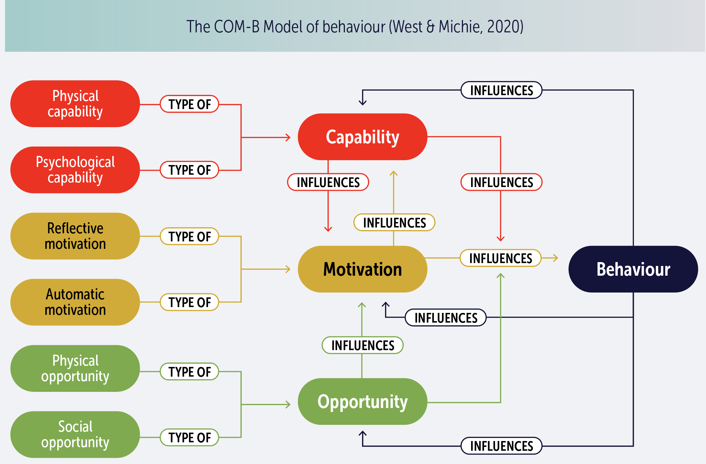
Why and how does behaviour change?
COM-B Model
Capability is an attribute of a person that together with opportunity makes a behaviour possible or facilitates it.
Opportunity is an attribute of an environmental system that together with capability makes a behaviour possible or facilitates it.
Motivation is an aggregate of mental processes that energise and direct behaviour.
Behaviour is individual human activity that involves co-ordinated contraction of striated muscles controlled by the brain.
Physical capability is capability that involves a person’s physique, and musculoskeletal functioning (e.g. balance and dexterity).
Psychological capability is capability that involves a person’s mental functioning (e.g. understanding and memory).
Reflective motivation is motivation that involves conscious thought processes (e.g. plans and evaluations).
Automatic motivation is motivation that involves habitual, instinctive, drive-related, and affective processes (e.g. desires and habits).
Physical opportunity is opportunity that involves inanimate parts of the environmental system and time (e.g. financial and material resources).
Social opportunity is opportunity that involves other people and organisations (e.g. culture and social norms).
Notes:
The COM-B model explains that for any behaviour to occur three things must be present, capability, opportunity and motivation.
Capability is about whether someone is physically and psychologically able to perform the behaviour.
Opportunity is about whether the environment allows the behaviour to happen.
Motivation is what directs and sustains behaviour.
All three elements interact.
Even if someone is highly motivated, the behaviour will not occur unless they also have the capability and the opportunity.
Capability and opportunity act as gates that must be open for motivation to translate into action.
Behaviour also feeds back into the system.
When people practise a behaviour it can strengthen their capability, change their motivation or create new opportunities.
For HR, the COM-B model provides a useful way to diagnose why a behaviour is or is not happening.
If a behaviour is missing we can ask whether it is because people lack the skill or knowledge, because the environment does not support it or because they are not motivated.
The answer helps target interventions more precisely and effectively.

Slide 11
Behavioural change techniques
Most behaviour change interventions contain several behaviour change techniques (not just one)
There are many such techniques:
Michie et al (2015) identified 93 behavioural change techniques.
Kok et al (2016) catalogued 99 behavioural change techniques.
Knittle et al (2020) identified 123 self-management behavioural change techniques.
No one technique necessarily ‘better’ than any other – it depends.
Notes:
Explaining why behaviour changes is complex and there are many different ways of influencing it.
Because of that, most behaviour change interventions use several techniques, not just one.
Researchers have identified large numbers of behavioural change techniques.
These include a wide range of methods such as goal setting, feedback, prompts, training, incentives, habit formation and many others.
Each technique works by influencing behaviour in a slightly different way.
For HR there are two key points.
First, there is no single best technique that works in all cases.
What works depends on the behaviour we are targeting and the context in which it occurs.
Second, effective interventions usually combine several techniques to reinforce each other.
In practice, this means that behaviour change in organisations rarely comes from one isolated action.
It is more likely to come from a set of coordinated actions that use multiple techniques to influence capability, opportunity and motivation together.
Understanding the range of available techniques helps HR teams make more informed choices when designing interventions.

Slide 12
Behavioural change techniques: Organisational behaviour management
Based on the ABC (Antecdents, Behaviour, Consequences) model Organisational Behaviour Management interventions focus on changing antecedents and/or consequences. In other words, to change behaviour we can do something before people emit the behaviour (antecedents) and/or do something after the behaviour has been emitted (consequences).
Antecedents refers to anything that triggers a behaviour. They are not causes as such.
“Antecedents are stimuli in the environment that (because of their previous association with consequences) increase the likelihood that a certain response will occur… Antecedents do not literally cause behaviour… They communicates information about behaviour and its consequences.”
Daniels & Bailey (2014)
Behaviour is an observable, measurable and specific action.
Consequences are outcomes that occur as a result of specific behaviours.
“Consequences are events that follow a behaviour and change the probability that the behaviour will recur in the future.” Daniels & Bailey (2014)
Notes:
Organisational Behaviour Management is an approach developed specifically for workplaces.
It is based on the ABC model, which stands for Antecedents, Behaviour and Consequences.
The model focuses on what happens before and after a behaviour.
To change behaviour, we can do something before people act, which involves antecedents, and we can do something after the behaviour, which involves consequences.
Antecedents are anything that triggers a behaviour.
They are not causes but signals that provide information about what will happen if the behaviour occurs.
For example, a deadline, an instruction from a manager or a visual prompt can all act as antecedents.
Consequences are what happen after the behaviour.
They determine whether that behaviour is likely to happen again.
Positive consequences, such as recognition or rewards, make behaviour more likely.
Negative or neutral consequences make it less likely.
For HR, OBM is practical because it helps diagnose and shape real behaviours at work.
It asks simple but powerful questions: what happens before the behaviour, what happens after it, and how can we change those conditions to make the desired behaviour more likely?
This model shifts focus away from attitudes or root causes and toward the observable patterns in the work environment that actually drive performance.

Slide 13
Behavioural change techniques: Organisational behaviour management
Examples of antecedents in the work environment:
 | Organisational communications with information about goals, objectives, priorities, accountabilities, job descriptions, policies (e.g, a list of objectives or targets for the next six months).
 | Instructions about these communications and what they mean for behaviour shared in workshops or training (e.g., a team discussion of how it will organize itself to meet communicated targets).
 | Instructions and requests from line managers, coworkers and customers (e.g., a client asks if you can extend the scope of an on-going project).
 | Agreements and contracts (e.g., a detailed service level agreement)
 | Representation of procedures such as checklists, standards, rules, flowcharts, colour coding, scripts (e.g., room-cleaning checklists used in hotels).
 | Resources including tools, materials, physical working conditions, physical layout (e.g., automated reminders from project management software/app).
 | Behaviour of others which may result in modelling or engaging in an opposite behaviour (e.g., arriving early for meetings if coworkers do it or observing someone making a mess in a shared kitchen prompts you to be tidy).
 | Self-managed antecedents such as self-talk, physical states, mental images (e.g., visualising a completed report that you’ve almost finished).
Notes:
These are examples of the kinds of antecedents that exist in most workplaces, which are things that happen before a behaviour and act as cues or signals for what to do.
They include communications about goals and priorities, instructions or requests from managers, contracts or procedures and the behaviour of others.
According to Daniels and Bailey, antecedents are most effective when they meet three conditions.
First, they happen immediately before the behaviour. A prompt to act now works better than one given hours earlier.
Second, they signal a meaningful consequence. People are more likely to respond if the outcome that follows matters to them.
Third, they are closely linked to the consequence. The clearer the connection between the cue and what happens after, the stronger its effect.
In short, antecedents are most powerful when they are timely, meaningful and clearly connected to what follows.

Slide 14
Behavioural change techniques: Organisational behaviour management
Four main categories or types of consequences.
Consequences that increase behaviour |  | Consequences that decrease behaviour
Positive reinforcement The behaviour gets you… Personal or public praise. Respect. Gratitude. Formal recognition. Gifts. Extra leave. | Negative reinforcement The behaviour helps you avoid… Disapproval. Having to stay late to finish a task. Embarrassment. Disappointing clients. Letting down colleagues. | Punishment The behaviour gets you… Criticism. Disapproval. Formal reprimand. Extension of probation. | Penalty The behaviour means you lose… Promotion opportunity. Overtime allowance. Respect from others.
Notes:
This slide shows the four main types of behavioural consequences described in Organisational Behaviour Management.
The key idea is that consequences are only meaningful if they actually change the likelihood of the behaviour happening again.
Many things might follow a behaviour, but only those that influence whether it will be repeated count as true consequences.
There are two kinds of consequences that increase behaviour.
Positive reinforcement happens when the behaviour gets you something you value, such as praise, recognition or rewards.
Negative reinforcement happens when the behaviour helps you avoid something unpleasant, such as disapproval or extra work.
There are also two types of consequences that decrease behaviour.
Punishment means the behaviour gets you something you do not want, like criticism or reprimand.
Penalty means you lose something you value, such as an opportunity or respect.
While punishment and penalty can reduce unwanted behaviours, they can also damage trust and motivation.
That is why Organisational Behaviour Management focuses mainly on positive reinforcement.
Encouraging and rewarding the right behaviours tends to build better relationships and more lasting change.
In other words, if we want behaviours to stick, the focus should be on creating positive consequences for doing the right things rather than punishing people for doing the wrong ones.

Slide 15
CRF Evidence-Based HR behaviour change model
>
>
>
>
STEP 1 |  | STEP 2 |  | STEP 3 |  | STEP 4
Identifying an organisational objective |  | Specifying the behaviour(s) that will contribute to that objective |  | Measuring current levels of the behaviours |  | Analysing the current level of behaviours their antecedents, blockers and consequences
What are the current most important organisational objectives that are relevant to HR (see examples in Driving Organisational Performance HR’s Critical Role)? Start with one of these objectives. Do you understand how in principle the organisation can achieve that objective? What is the role of employee behaviour in achieving that objective? |  | Which specific behaviours need to be performed? How can these be pinpointed? In which employees and where? When exactly do employees need to exhibit these behaviours? At what levels or frequency do these behaviours need to be exhibited? Why and how will these behaviours if exhibited contribute to that objective? |  | Having carefully described and defined these behaviours, how can you assess or measure them? What specific methods will you use? How valid and reliable are these methods? Can employees measure these behaviours for themselves? |  | What exactly are the current levels? How do these compare to the ideal identified in Step 2? Where are main gaps? Use the ABC model to list all relevant antecedents (including blockers) and consequences (see separate table for more details) Discuss possible reasons for, and ways of closing, these gaps around antecedents and consequences. What, if any, are the environmental or contextual factors that are may prevent the performance of the behaviours? What can be done to deal with these?
Notes:
This part of the model shows the first four steps in an evidence-based approach to behaviour change.
It starts with identifying what matters most to the organisation and connects that through to understanding current behaviours and what influences them.
Step 1 is about identifying the organisational objective.
We start by asking which objectives are most relevant to HR and how employee behaviour helps achieve them. It is about linking behaviour to strategy and understanding what the business is trying to do and how people’s actions contribute to that.
Step 2 focuses on specifying the behaviours that matter.
Once we know the objective, we pinpoint the exact actions that will drive it, who needs to do what, when and how often. The goal is to make behaviours specific, observable and measurable so that we can see whether they are actually happening.
Step 3 is about measuring current levels of behaviour.
We look at how often the desired behaviours occur now, how we can assess them and whether our measurement methods are reliable. This gives us a baseline to track change over time.
Step 4 involves analysing the current levels of behaviour and understanding what shapes them.
We use the ABC model to map out antecedents, blockers and consequences. This helps identify what might be encouraging or discouraging the behaviour and what can be adjusted in the environment to close any gaps.

Slide 16
CRF Evidence-Based HR behaviour change model ^{[2]}
>
>
>
STEP 5 |  | STEP 6 |  | STEP 7 |  | STEP 8
Giving behavioural feedback about the current level of behaviour to employees |  | Setting goals and subgoals to specify shift in behaviours is required |  | Affirming appropriate behaviours by rewarding |  | Evaluating change and adjusting
Share the information with employees. Show which gaps exist and where. |  | Set very specific goals with individuals and teams about levels they need to get to and when. Set sub-goals where necessary, specifying which intermediate or sub-goals need to be achieved in order to achieve main goals. |  | Find ways of providing positive reinforcement when sub-goals and goals are being achieved or behaviour is moving in the right direction. This can include praise, tangible rewards, time off, formal recognition. |  | To what extent have goals been met? What gaps still exist and why? What else needs to be changed? Return to Step 1 and check that each Step has been completed appropriately. Adjust any that require it.
>
Notes:
Step 5 is about giving behavioural feedback.
Once we have measured behaviours and identified gaps, we share that information with employees.
This helps people understand where they are now and what needs to improve.
Feedback should be specific, constructive and focused on behaviours rather than attitudes or outcomes.
Step 6 focuses on setting goals and sub-goals.
We work with individuals and teams to define exactly what level of behaviour is needed and by when.
Setting smaller sub-goals helps track progress and maintain momentum.
The clearer and more specific the goals, the easier it is for people to know what to do differently.
Step 7 is about affirming appropriate behaviours through reward.
When people make progress or achieve sub-goals, it is important to recognise and reinforce that success.
This can take many forms, such as praise, formal recognition or small tangible rewards.
Positive reinforcement strengthens the link between the behaviour and its value to the organisation.
Step 8 is about evaluating change and adjusting.
We review how far the goals have been met, where gaps remain and what else may need to change.
This step closes the loop by returning to Step 1 to check whether the process has been followed effectively and whether further adjustments are needed.
Taken together, these steps ensure that behaviour change is measurable, reinforced and continuously improved, rather than treated as a one-off initiative.

Slide 17
Conclusion
Behaviour change
>
    By having some understanding of these theories and techniques and, equally important, a very good understanding of the context and the organisational objectives, we vastly increase the chances that we will identify which specific behaviours need to change, to what ends and how we can best bring about such behaviour changes.

