Slide 1
The HR Function and Risk Management:
Navigating Complexity with Resilience
Research Overview Slide Deck

Slide 2
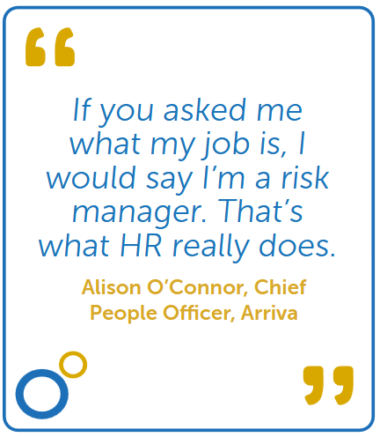
Introduction
Notes:
Many organisations operate under a paradox: enterprise value is increasingly shaped by human judgement and behaviour, yet enterprise risk management and HR functions have historically evolved along largely parallel trajectories.
This separation between people governance and enterprise risk oversight is becoming progressively difficult to justify in conditions of uncertainty and rapid change, representing a structural weakness in organisational resilience that HR is well placed to contribute to addressing. Rather than being positioned as the owner of enterprise risk management, HR is better understood as the function responsible for helping to shape the organisational conditions through which contemporary risk is identified and managed.

Slide 3
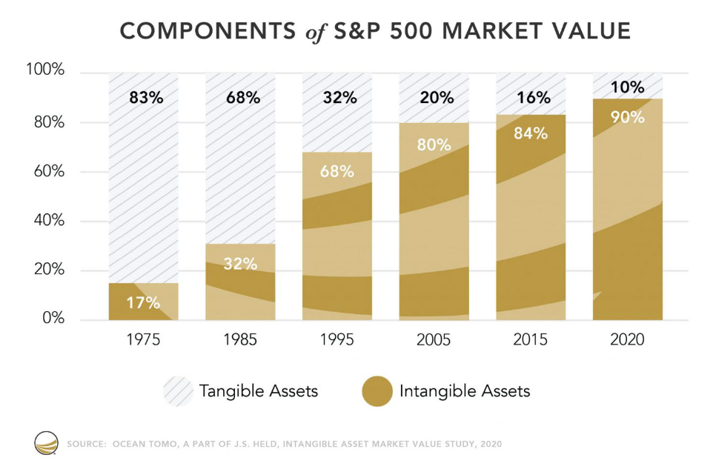
Where enterprise value has shifted and why risk oversight must follow
Notes:
The distinction between the governance of risk and the governance of people is increasingly difficult to sustain in an environment where corporate value is predominantly created through intangible and human-mediated assets.
Intangible assets describe the part of a company’s value that comes from how it operates and what it knows, rather than from the physical or financial assets it owns.
Examples include:
• Brand (customer trust and reputation)
• Intellectual property (patents and trade secrets)
• Technology and software (software code and algorithms)
• Customer relationships (long term contracts and switching costs)
• Data (proprietary datasets and analytical insight)
Ocean Tomo’s Intangible Asset Market Value (2020) offers longitudinal analysis of the S&P 500 and shows a fundamental change in the composition of market value. In 1975, intangible assets accounted for approximately 17 percent of total market value. By 1995, this figure had increased to approximately 68 percent and by 2020, intangible assets accounted for approximately 90 percent of total market value.

Slide 4
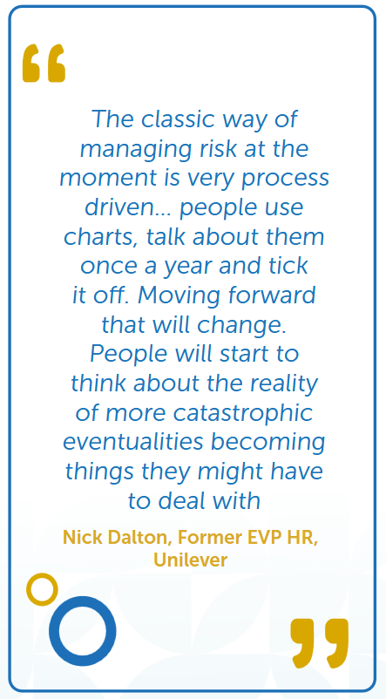
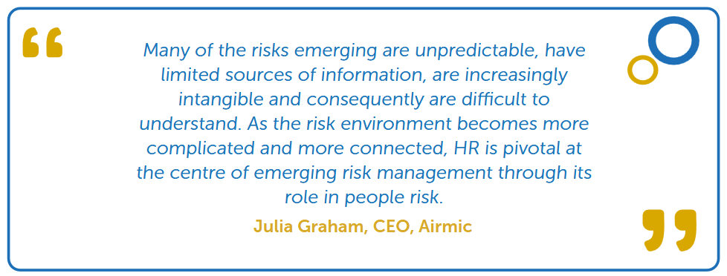
The changing dynamics of enterprise risk and the limits of prediction
Notes:
As enterprise risk becomes increasingly interconnected and uncertain, its impact is determined less by the accuracy of prediction than by the quality of organisational judgement exercised under pressure, making the governance of decision-making conditions central to effective risk oversight.
Risk no longer presents as a series of isolated events, but as interconnected pressures that interact and amplify across the organisation.
For example, the rapid shift to remote and hybrid working, initially treated as a discrete operational response to the COVID-19 pandemic, has generated sustained knock-on effects across workforce capability, organisational culture, leadership effectiveness, technology and employee wellbeing in ways that could not have been fully anticipated at the outset.

Slide 5
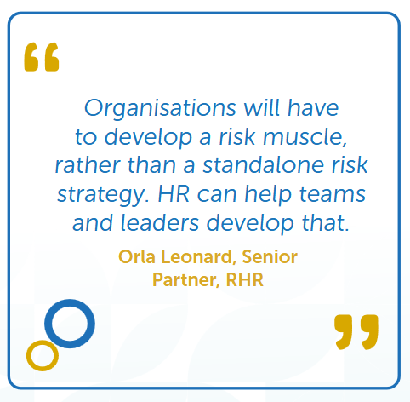
From predictive risk management to organisational risk capability
Notes:
Taken together, the misalignment between asset-based risk oversight and the growing limits of prediction points to a shift in how enterprise risk capability must be developed.
In conditions where risk is embedded in judgement and unfolds through human systems, effective risk oversight depends less on centralised frameworks and more on the organisational conditions that shape how decisions are made in practice.
With visibility across the workforce, organisational design and leadership capability, HR occupies a structurally distinctive position in relation to enterprise risk. If risk now turns on judgement under pressure, boards need a clearer line of sight into the people conditions that shape that judgement.

Slide 6
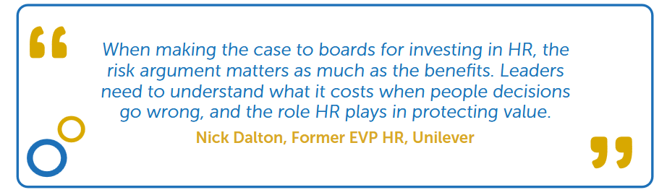
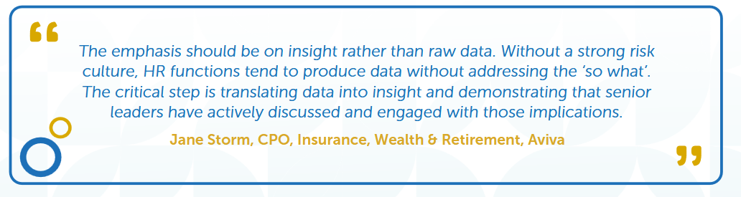
The role of the board
Notes:
Boards are taking greater ownership of people risk, but are still building the capability to interpret it, creating growing demand for HR to translate workforce insight into enterprise-level judgement.
Boards are no longer treating people issues as an operational or delegated concern. They increasingly recognise workforce and capability decisions as material to enterprise value, resilience and risk.
At the same time, many boards still lack the capability to interpret people-related risk with confidence. Research from CIPD in 2023 found that only 2 percent of organisations have HR representation at executive board level, and that fewer than a third of FTSE 350 boards include HR expertise in either executive or non-executive roles.
There are signs that this is beginning to change. Research from the Conference Board, reported via the Harvard Law School Forum on Corporate Governance in 2025, shows that CHROs are becoming more directly engaged with boards and are contributing more actively to strategic and enterprise risk discussions.
Together, this points to a shift in what boards expect from HR: not only more reporting, but clearer interpretation of how people dynamics translate into enterprise risk and strategic choice.

Slide 7
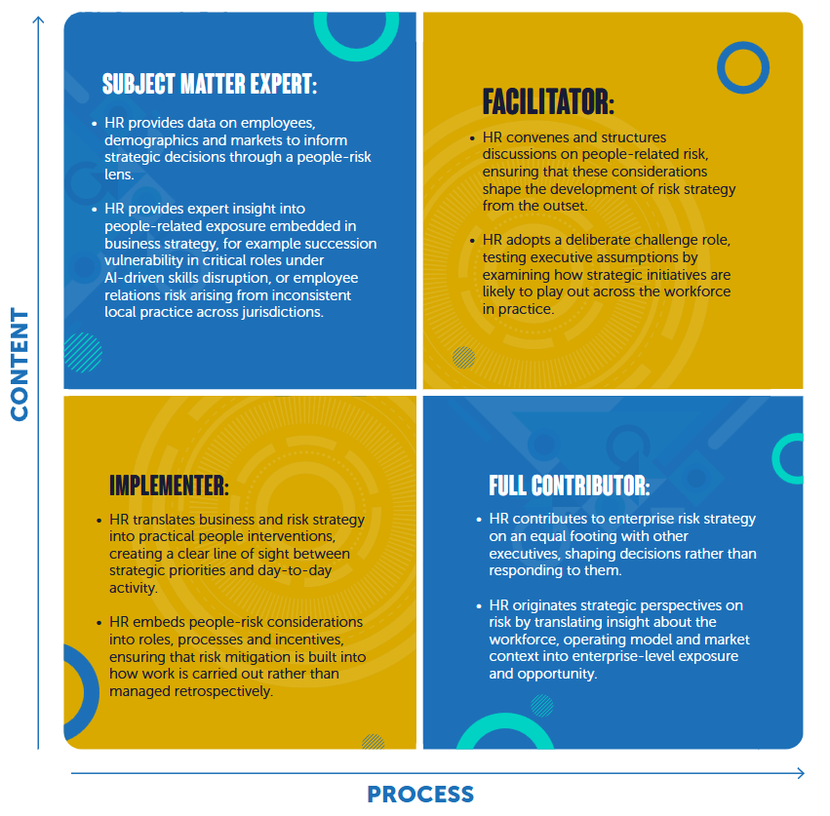
The role of the HR leader
Notes:
For a video overview of the role of the HR leader, go here:
Our research offers four ways HR leaders may engage with enterprise risk in practice. These can be understood through a two-by-two matrix that reflects both the depth of risk insight HR contributes and the extent to which it shapes how risk strategy is formed. Which an HR leader adopts depends on factors, such as:
• Individual capability
• Organisation expectations
• The needs and cycle time of the organisation
• Relationships with the CEO and executive team
In practice, HR leaders may move between roles over time rather than occupy a single position on the matrix. Some roles also create inherent tension. For example, acting as a ‘full contributor’ involves shaping the substance of decisions, while the ‘facilitator’ role focuses on shaping the process through which those decisions are developed. Where HR is expected to act as a ‘full contributor’ and no dedicated ‘facilitator’ exists, another executive or function may need to take on that role, allowing the executive team to focus fully on decision content
On the following page, you’ll see examples for each of the four quadrants

Slide 8
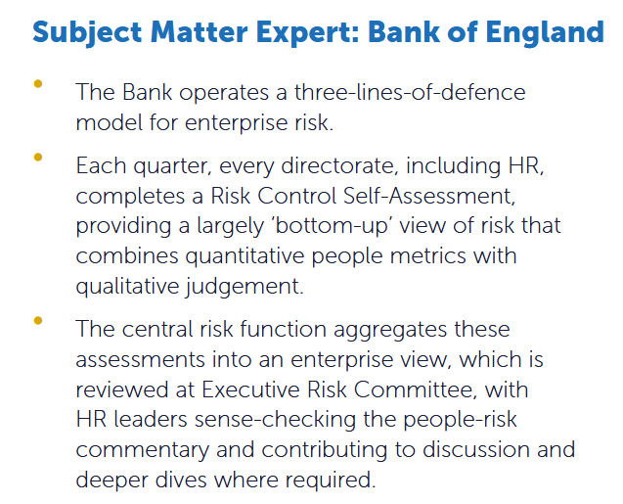
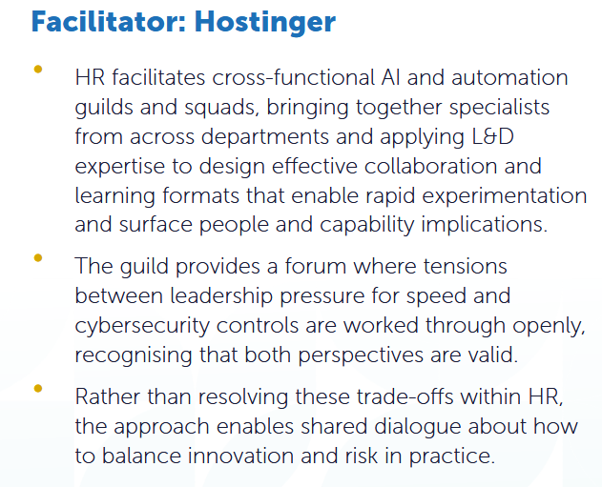
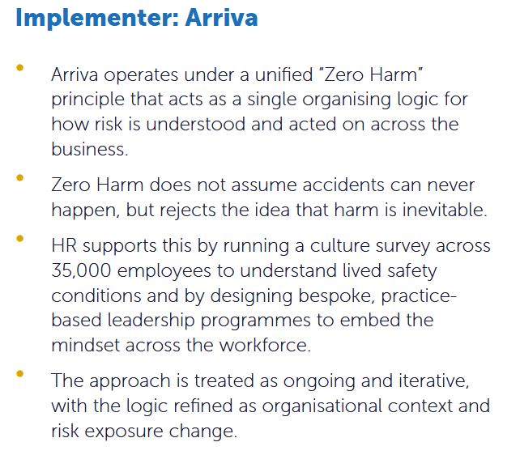
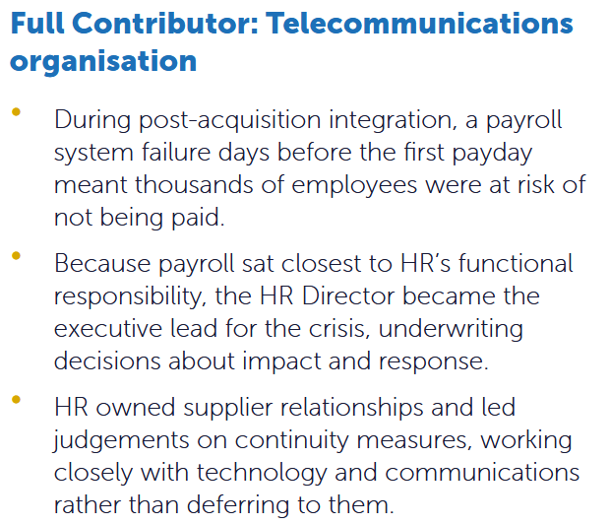
Case Studies: the four roles

Slide 9
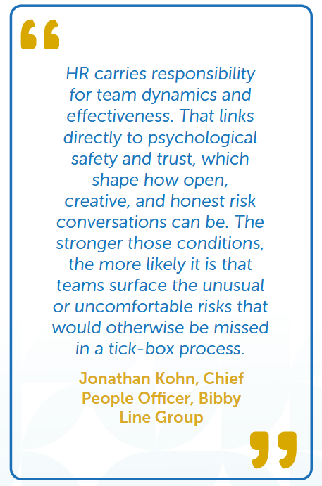
Engaging with enterprise risk: employee relations
What’s Changing?
A more litigious and rights-driven workforce
Loss of organisational containment through social and digital platforms
AI-enabled escalation of disputes
Fragmentation of shared organisational context
How are organisations responding?
Recognising managers as the primary risk control point
Using labour and union insights
Balancing psychological safety with decision accountability
Using systems and data to determine whether risk is visible or hidden
Notes:
Employee relations is often treated as a reactive or compliance-focused activity. In practice, it is one of the earliest points at which emerging enterprise risk becomes visible. The way concerns are raised and responded
to reflects underlying organisational conditions and shapes how risk is likely to escalate when pressure increases.
What’s changing?
Employee relations is being reshaped by forces that can lead to issues escalating at a pace and scale that would not have occurred in the past.
A more litigious and rights-driven workforce
Loss of organisational containment through social and digital platforms
AI-enabled escalation of disputes
Fragmentation of shared organisational context
How are organisations responding?
Recognising managers as the primary risk control point. Serious employee relations issues are typically preceded by earlier concerns that are not addressed consistently or in time. This places managerial judgement at the front line of containment, with HR processes operating as a backstop rather than the primary control
Using labour and union insights. As collective bargaining strengthens, union relationships are increasingly being used to shape decisions earlier, rather than to discuss issues after conflict arises.
Balancing psychological safety with decision accountability. Psychological safety reduces risk when it helps surface issues that may be missed by formal processes and enables concerns to be raised early. However, it only supports risk reduction when anchored in disciplined problem-solving and clear decisions.
Using systems and data to determine whether risk is visible or hidden. Research from AdviserPlus finds that less than 40 percent of large organisations report full availability of employee relations metrics providing insight into trends, root causes and consistency across cases. Weak systems turn employee relations into a blind spot rather than an early warning function

Slide 10
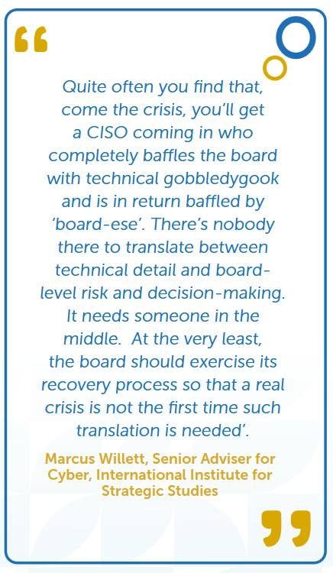
Engaging with enterprise risk: cyber and technology
What’s Changing?
Cyber risk is increasingly treated as inevitable rather than avoidable
Cyber risk is increasingly unknown, unpredictable and unbounded
The cyber-attack surface is now distributed across the workforce
AI has lowered the threshold for misuse and error
How are organisations responding?
Defining cyber resilience through data
Treating silence as a greater risk than error
Preparing leadership communication in advance for when controls fail
Positioning HR as a translator between technical risk and enterprise decision-making
Notes:
Cyber and technology risk has extended beyond a purely technical issue owned by specialists and managed through controls. As advanced technologies become more widely accessible and less predictable, risk is increasingly shaped by everyday behaviour and judgement, determining whether incidents are contained or escalate into enterprise-level crises.
What’s changing?
Cyber risk is no longer defined by isolated breaches or technical failure, but mirrors the characteristics of modern risk: persistent, uncertain, widely distributed and shaped by everyday human judgement.
Cyber risk is increasingly treated as inevitable rather than avoidable
Cyber risk is increasingly unknown, unpredictable and unbounded
The cyber-attack surface is now distributed across the workforce
AI has lowered the threshold for misuse and error
How are organisations responding?
Defining cyber resilience through data that reveals how people behave under real conditions, not what they have been trained to know. Organisations are moving beyond awareness-based training towards observing behaviour
in practice. HR teams are using behavioural data, such as repeated credential failures, reporting delays and escalation speed, to assess genuine organisational readiness rather than assumed competence
Treating silence as a greater risk than error. Cyber risk escalates when people fail to speak up, not only when mistakes occur. When individuals hesitate to report incidents out of fear of blame, issues that could be contained quickly can escalate into enterprise-level crises
Preparing leadership communication in advance for when controls fail. Because cyber incidents unfold under uncertainty, organisations are increasingly preparing communication playbooks before incidents occur. Pre-agreed holding statements and escalation routes allow leaders to communicate clearly even when information is incomplete.
Positioning HR as a translator between technical risk and enterprise decision-making. HR plays a critical role in aligning judgement and behaviour across the organisation when incidents unfold under pressure. In practice, this involves helping leaders understand what technical updates mean for people and operations, enabling coordinated action in conditions of uncertainty.

Slide 11
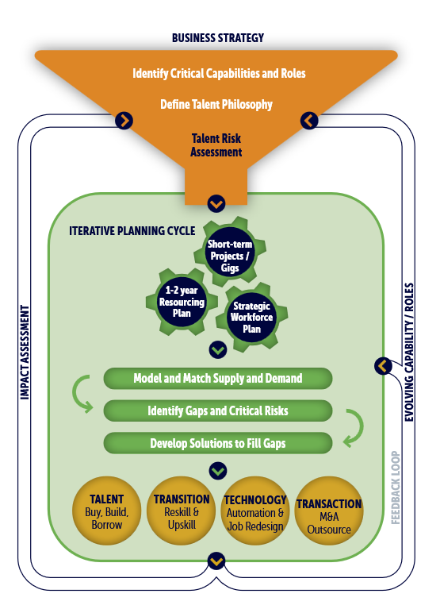
Engaging with enterprise risk: talent
What’s Changing?
A shrinking and ageing workforce
Misalignment between education systems and employer needs
Persistent shortages in critical skill areas
The destabilising impact of AI on jobs and careers
How are organisations responding? CRF’s framework for dynamic talent planning
First, alignment between business strategy and talent strategy
Second, an iterative approach to planning and action
Third, a data-informed feedback loop
Access further information on how to prepare your talent strategy for future risk here
Notes:
Talent is no longer primarily a workforce planning challenge, but a source of structural enterprise risk shaped by long-term shifts in labour supply and the pace of technological change.
In this context, talent risk is not limited to shortages or capability gaps. It also includes the risk of missed opportunity when organisations lack the skills, experience or organisational capability required to enter new markets, develop
new products or sustain innovation over time. In such cases, the cost of talent failure is not only operational strain, but the loss of future growth options and strategic relevance.
What’s changing?
The talent landscape is being reshaped by constraints that restrict labour supply and reduce organisations’ ability to adapt, increasing reliance on skills that are difficult to replace.
A shrinking and ageing workforce
Misalignment between education systems and employer needs
Persistent shortages in critical skill areas
The destabilising impact of AI on jobs and careers
How are organisations responding?
Organisations are responding to uncertainty by building resilience into how talent is planned, deployed and developed. The focus is shifting from prediction to preparedness, recognising that flexibility is now the primary defence against talent risk.
CRF has developed a framework for dynamic talent planning that helps organisations identify emerging talent risks and maintain multiple response options rather than relying on a single fixed plan.
The framework has three elements:
First, alignment between business strategy and talent strategy. This requires HR to be involved early in strategic discussions and to translate strategic choices into an understanding of the talent risks they create.
Second, an iterative approach to planning and action. Talent planning is treated as an ongoing business conversation rather than an annual exercise. This allows organisations to test approaches, learn quickly and respond to risks as they emerge
Third, a data-informed feedback loop. This has two components. One focuses on impact assessment, using performance data and stakeholder input to understand what is working and adapt accordingly. The other focuses on bottom-up insight into how work is changing as AI tools are used in daily roles, and what this means for job design, capability requirements and people risk.
For further detail on the report and how to prepare your talent strategy for future risk, please click here: https://www.crforum.co.uk/wp-content/uploads/2026/01/Future-Ready-Talent-Management-Report-1.pdf

Slide 12
The Conditions, Signals, Actions Framework
Although enterprise risk in modern organisations is increasingly unpredictable, it often follows a broadly consistent pattern. Risk tends to accumulate through organisational conditions, surface through early human signals and escalate or stabilise depending on the actions exercised under pressure.
This framework provides a practical lens through which HR leaders can engage
with people-mediated risk, directing attention upstream of formal risk metrics while remaining aligned with established risk governance.
At its core, the framework helps HR leaders answer three questions:
• Where is risk building?
• How might it escalate?
• What actions should be taken?
Access the meeting document here.
Notes:
CRF have built a slide deck to use in a meeting discussion to work through our conditions, signals, actions framework for your organisation. You can access it here:

Slide 13
The HR Function and Risk Management:
Navigating Complexity with Resilience
Conclusion
Notes:
Enterprise risk is increasingly shaped by intangible value and human judgement, yet many organisations still treat risk governance and people governance as separate disciplines.
While traditional risk frameworks remain essential for baseline control, resilience now depends on organisational readiness when information is incomplete and decisions must be made under pressure.
In this context, HR is not the owner of enterprise risk management as a system, but a critical contributor to risk capability by shaping the conditions that determine decision quality, surfacing early human signals and strengthening readiness across mission-critical activities.
The core shift is from managing risk on paper to building the people and leadership capacity to respond well when disruption arrives.

