Slide 1
The Conditions, Signals, Actions Framework
A practical framework for HR leaders to engage with people-mediated risk
Discussion length: 30-90 minutes

Slide 2
What the framework is for
The framework offers a practical lens for thinking about people-mediated risk. It helps direct attention upstream of formal risk metrics and keeps discussion focused on three linked questions.
Conditions
Signals
Actions
Where is risk building?
How might it escalate?
What actions should be taken?
The relatively enduring features of the organisation that shape how people operate and make decisions over time.
Early indicators that conditions are beginning to strain and that closer attention is warranted.
The decisions made once risk begins to escalate, especially the choices made under pressure.
Used together, these three lenses help a group move from diagnosis to action without losing sight of the organisational context around the risk.

Slide 3
How to use this framework
Suggested flow
Frame the risk topic
Good prompts for the group
1
Agree the issue, decision or pressure you want to explore.
Start specific
Use both data and judgement
Look for conditions
Anchor the conversation in a live issue: a business change, a capability gap, a recurring people problem or a pressure point that feels hard to resolve.
The framework works best when qualitative insight is discussed alongside hard data rather than treating one as more valid than the other.
2
Identify the underlying features of the organisation that may be allowing risk to build.
Look for signals
3
Stay upstream
Be clear on ownership
Surface the early indicators that suggest those conditions are starting to strain.
Do not jump too quickly to solutions. Spend enough time on conditions and signals first so the group can see what is driving the risk.
End with actions, decision points, escalation routes and a short list of signals to keep watching.
Discuss actions
4
Work through how decisions are being made now and what should happen next.
Close with owners
Aim for better judgement
5
The goal is not a perfect risk register. The goal is stronger organisational readiness and better decisions under pressure.
Agree actions, owners and what should be watched over the next few weeks.

Slide 4
Conditions: Where is risk building?
Conditions are the relatively enduring features of the organisation that shape how people operate and make decisions. They define the environment in which risk may accumulate over time.
Discussion Prompts
Where could risk be quietly accumulating?
What in our structure or governance may be contributing?
Look beyond the immediate problem. What features of the operating environment may be making it more likely?
Think about handoffs, blurred accountability, overloaded decision-makers, conflicting priorities or weak coordination.
What to look at
Decision architecture: where authority sits and whether accountability is clear across functions or levels.
Operating model and organisational design: where complexity or interdependence makes coordination difficult.
Resourcing and capacity assumptions: the underlying expectations around workload and pace.
Incentive and performance frameworks: what the organisation signals it really prioritises.
Governance and oversight arrangements: how regularly and deeply risk and performance are reviewed.
What assumptions are we making about capacity?
What does the system reward in practice?
Are we assuming teams can absorb more, move faster or cope for longer than is realistic?
Do targets, incentives or leadership signals encourage speed, control or cost reduction in ways that may increase exposure?
Capture
Write down the top two or three underlying conditions the group thinks matter most.
Notes:
[Sources]

Slide 5
Signals: how might it escalate?
Signals are early indicators that suggest conditions are beginning to strain. They do not identify root causes or prescribe responses, but they show that closer attention is warranted.
Discussion Prompts
What are we noticing first?
Where are issues surfacing too late?
Talk about both hard data and softer qualitative signals. What is changing in tone, pace, behaviour or workload?
Look for signs that concerns are being delayed, rerouted or only reaching senior leaders when they are already serious.
What to look at
Shifts in employee voice: how concerns surface, and what changes in tone, listening data or survey insight may suggest.
Escalation patterns: issues emerging later than expected or bypassing established routes.
Capacity pressure indicators: sustained increases in absence, turnover or overtime, especially in specific roles.
Reliance on key individuals: growing dependency on certain people to resolve issues or maintain continuity.
Employee relations activity: movement in grievance or dispute volumes, and recurring themes behind them.
Which roles or teams feel most stretched?
Who are we relying on too heavily?
Use the discussion to pinpoint hotspots rather than talking about the organisation in general terms.
Ask whether continuity depends on a small number of people, informal workarounds or heroic effort.
Capture
Agree the three to five signals the group will actively monitor over the coming weeks.

Slide 6
Actions: what needs to happen?
Action is what happens once risk begins to escalate. It becomes visible through the choices people make under pressure, including how fast issues move, what trade-offs are made and how challenge is handled.
Discussion prompts
What should happen now?
What trade-offs do we need to manage consciously?
Be explicit about decisions, escalation points and immediate actions rather than ending with general intentions.
Surface the tensions between speed, delivery, cost, control and people impact before they are made implicitly.
What to look at
Speed and direction of escalation: are issues addressed promptly at the right level?
Trade-offs made under pressure: how are delivery, cost or speed balanced against longer-term exposure?
Use of authority in uncertainty: do people act within their mandate or defer decisions upward?
Response to challenge: what happens to dissenting views or uncomfortable information when pressure is high?
Consistency of decisions: are comparable risks handled in similar ways, or differently depending on who is involved?
Who needs authority and clarity in advance?
What would make our response stall?
Some risks escalate too quickly for long diagnosis. Ask what should already be agreed before a crisis hits.
Discuss whether accountability, communications, access to plans or crisis roles are clear enough in practice.
Capture
Agree action owners, timings, escalation routes and the signals that should trigger review.

Slide 7
Pulling the discussion together
Use this final slide to turn the conversation into a practical follow-up plan.
Risk area
How it could escalate
Immediate action
Owner
Review by
What do we need to act on now?
What should we keep watching?
When will we revisit this?
1
2
3
07
Notes:
[Sources] - This slide translates the report’s framework into a meeting output format. Underlying concepts are based on the Conditions, Signals and Actions framework and the report’s emphasis on organisational readiness and timely decisions under pressure on pages 29-33: https://www.crforum.co.uk/wp-content/uploads/2026/02/CRF-Research-HR-Function-and-Risk-Management.pdf

Slide 8
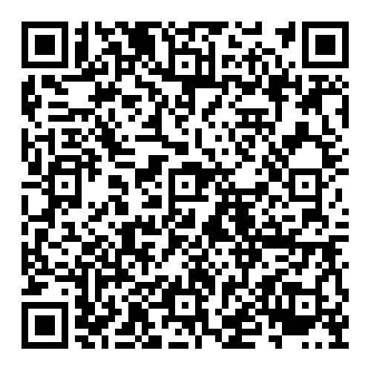
The HR Function and Risk Management
Scan the QR code to access report

