Slide 1

An evening at the Financial Times
FT Executive Briefings
Making Sense of Market Complexity: Volatility, Signals and Strategic Decisions
17 June 2026 | 18:00 BST | London
Katie Martin — Markets Columnist, Financial Times
Bjorn Beam - Technology Analysis & Geopolitical Intelligence Expert

Slide 2


© Headspring Executive Development
A joint venture of FT | IE Business School

Slide 3


BUSINESS-FIRST, PRACTICAL AND EVIDENCE-BASED
Our Approach
Strategic Areas
HR Capabilities
© Headspring Executive Development
A joint venture of FT | IE Business School

Slide 4
CRF’S INTEGRATED LEARNING OFFERING
BUILDING HR CAPABILITY THROUGH
EVENTS
CUSTOM LEARNING
OPEN LEARNING
Expert perspectives, peer learning, debate and networking
Capability building fully tailored to your organisation
Scheduled learning open to all HR professionals
ON DEMAND LEARNING
ADVISORY SUPPORT
SPECIALIST NETWORKS
Self-paced digital learning for individuals and teams
Consult our international network of 250+ organisations
Employee and Industrial Relations, Work Psychology
UNDERPINNED BY CRF RESEARCH
Evidence-based insight and practical frameworks; practitioner focused and academic backed
© Headspring Executive Development
A joint venture of FT | IE Business School

Slide 5


INTERNATIONAL CONFERENCE
TURNING UNCERTAINTY INTO ADVANTAGE
Malta
5th – 7th October 2026
250+
Faculty Includes:
CEOs, Professors, Experts & CHROs
Senior HR Leaders
Explore the spekers via the QR code
“I’ll distil my feedback down to two things – exceptional content and genuine connections. Your knowledge of your community and what we need to hear is second-to-none. However, your ability to build rapport and create genuine connections is the true differentiator.”
Previous attendee
© Headspring Executive Development
A joint venture of FT | IE Business School

Slide 6
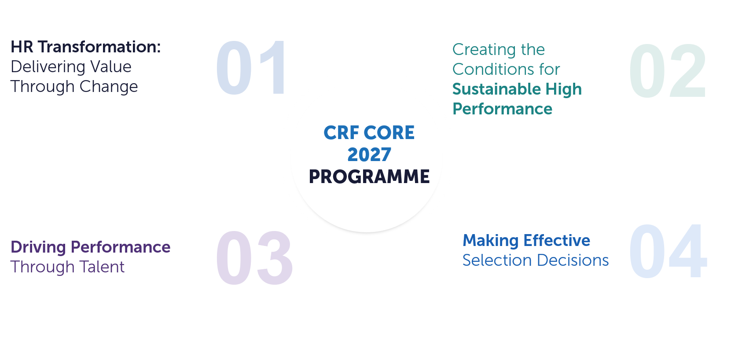
WHAT WE’RE EXPLORING IN 2027
© Headspring Executive Development
A joint venture of FT | IE Business School

Slide 7



OUR SPEAKERS
KATIE MARTIN
BJÖRN BEAM
MARKET COLUMNIST
EX-CIA, HEAD OF GEOPOLITICAL AND TECH RESEARCH, HEADSPRING FACULTY
© Headspring Executive Development
A joint venture of FT | IE Business School

Slide 8
Agenda
Setting the Scene
War, Bonds & the Dollar
The Stock Market Party
Markets & Real Life
Financial Literacy
© Headspring Executive Development
A joint venture of FT | IE Business School
Notes:
2

Slide 9
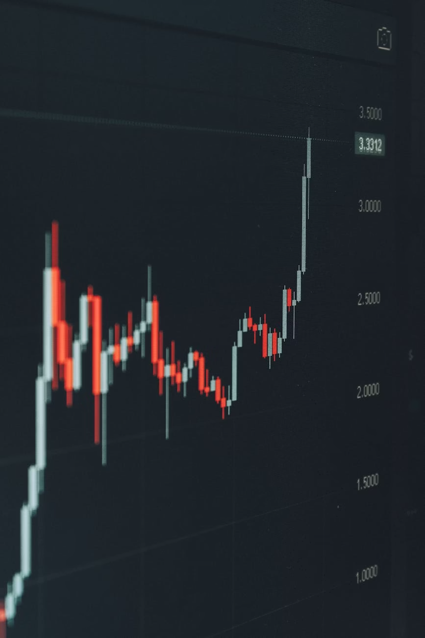

THE CENTRAL THEME
Radical Uncertainty
…meets an equally powerful force: greed.
Markets ≠ Vacuum
The Paradox of 2026
Markets drive geopolitics just as much as geopolitics drive markets. You cannot think about one without the other.
Extraordinary uncertainty among economists and investors — yet an almost nihilistic thirst for risky investments. One of the more peculiar environments ever seen.
© Headspring Executive Development
A joint venture of FT | IE Business School
Notes:
3

Slide 10

Where We Were: January 2026
The Setup
🔥 Melt-Up Mode
Everything was pointing markets' way. Investors were rushing upward — confident, exuberant, and largely unconcerned.
  Trump's tariff shock of April 2025 had been shaken off
  "One Big Beautiful Bill" promised tax rebates for the masses
  The Federal Reserve poised to cut interest rates
A rare moment of getting it right: calling the melt-up in a January column.
© Headspring Executive Development
A joint venture of FT | IE Business School
Notes:
4

Slide 11
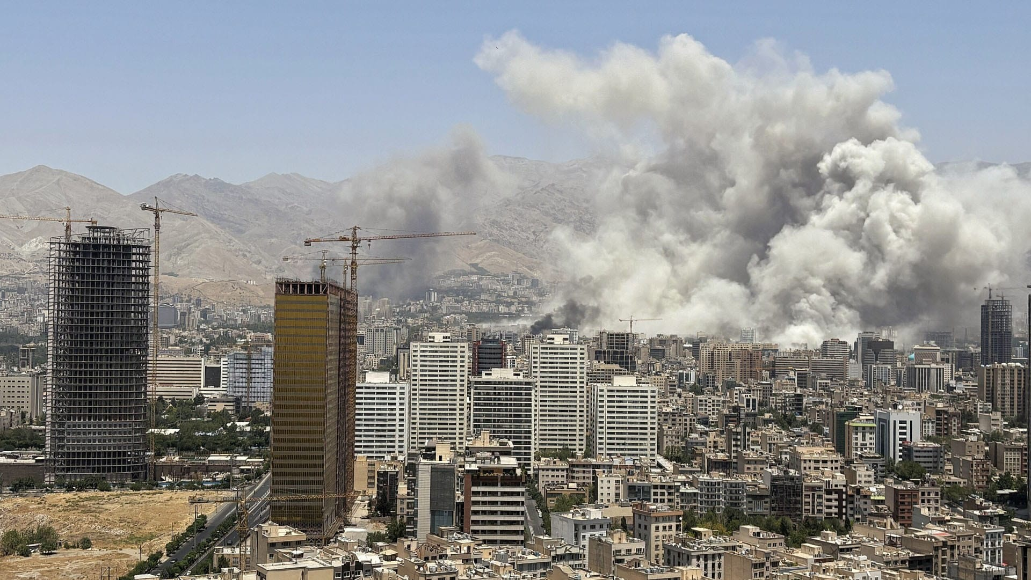
THE SHOCK
The War in Iran: Changed Everything and Nothing
© Headspring Executive Development
A joint venture of FT | IE Business School
Notes:
5

Slide 12
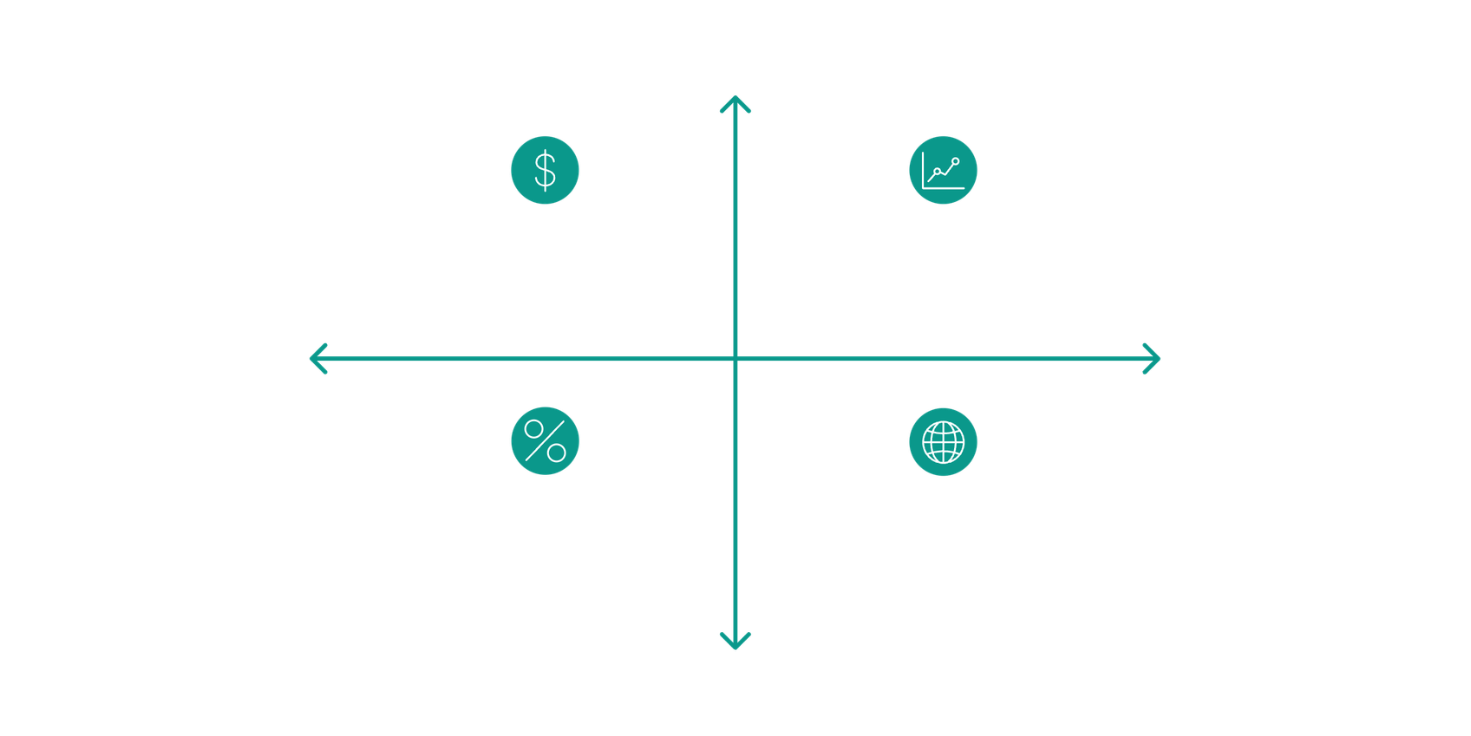
The Two Big Red Flags 🚩🚩
What didn't happen when markets got nervous tells us far more than what did.
The Dollar Didn't Jump
Bonds Didn't Recover
When the going gets tough, the dollar is supposed to be investors' safe haven. It wasn't this time. A clear signal that the Trump administration has chipped away at trust in the dollar and the foundations of global finance.
Unlike stocks, bonds remained much weaker than before the war — keeping borrowing costs higher across the world. Investors are nervous about inflation, the mortal enemy of bonds.
Low confidence
Weak Dollar: Loss of confidence
Weak Bonds: Fears of inflation
Global Risk
Inflationary Pressure
Likely interest rate rises
Global capital outflows
Higher interest rates
© Headspring Executive Development
A joint venture of FT | IE Business School
Notes:
6

Slide 13

Party Time
Stock markets. Entirely unbothered.
The AI Listings Boom
Massive new stock-market listings, mostly clustered around AI. The entire financial system is geared around making sure those listings go well.
Supply Pressure
When you ignite a massive increase in the supply of stocks, you can get lower prices — some weak spots are already appearing.
A Last Hurrah?
This carnival atmosphere is deeply unnerving. Don't be surprised to see a weak patch in markets in the coming months — especially as US inflation proves conspicuously sticky.
Trump wants Kevin Warsh to cut rates. Warsh may end up having to raise them. That's never what stock markets like to see.
© Headspring Executive Development
A joint venture of FT | IE Business School
Notes:
7

Slide 14
The State of Play: Mid-2026
⚡ Energy Specialists
📉 Debt Specialists
📈 Stock Markets
Totally freaking out. Strait of Hormuz risk. Running down of global reserves. Potential $150/barrel oil. Worst may still be to come.
Mildly freaking out. Bonds weak. Borrowing costs elevated globally. Governments piling on new debt. Inflation risk very real.
Party time. AI listings boom. Exuberance. Extraordinary spectacle. Quite amazing to witness — and quite unnerving.
Nobody knows how energy prices will pan out. Benchmark oil could shoot to $150 a barrel. The sheer disconnect between these three worlds is one of the most peculiar market environments ever seen.
© Headspring Executive Development
A joint venture of FT | IE Business School
Notes:
8

Slide 15
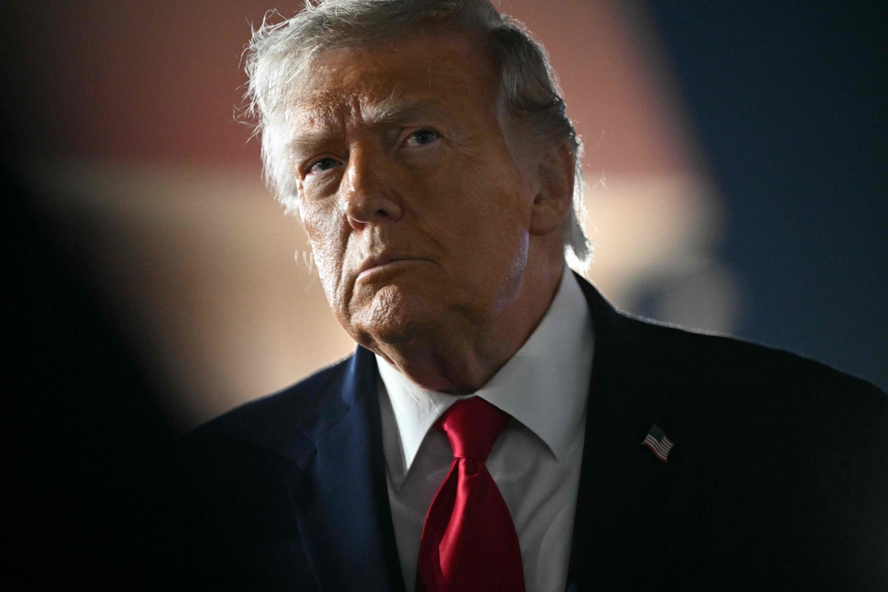
MARKETS & REAL LIFE
Markets Don't Exist in a Vacuum
Trump's U-Turn on Tariffs (April 2025)
It was a wobble in US government bond markets — investors refusing to buy US Treasuries — that forced Trump to abandon his "ludicrous" trade tariffs. He called the market "yippy." What actually happened was a financial veto.
Inflation Punishes Incumbents
In every major election in recent years, investors have punished incumbent parties whenever inflation takes hold. November's US mid-terms will test whether the US public will swallow the rise in energy and food prices.
The UK Gilt Market
A small but heavily indebted market, regularly battered by global forces. The UK simply cannot afford to let borrowing costs push much higher. Politicians of all stripes struggle to understand this — and the resulting distrust of bond markets is poorly-informed and factually wrong.
© Headspring Executive Development
A joint venture of FT | IE Business School
Notes:
9

Slide 16

Bond Markets: The Controlling Mechanism
Who Actually Owns Bonds?
The Political Reality
Not "dreadful grubby speculators." Bond investors are:
Financial markets have the power to dictate — or at least contribute to — national politics and geopolitics.
Periods of weakness in stocks and bonds act as a meaningful brake on political ambitions. A controlling mechanism, if you will.
  Holders of your pension and mine
  Insurance companies
  Institutional funds
We have let a very unhealthy distrust of bond markets take hold. It's poisoning public discourse. And often it's flat-out factually wrong.
This isn't abstract. It has played out in the UK, the US, and across Europe in just the past 18 months.
© Headspring Executive Development
A joint venture of FT | IE Business School
Notes:
10

Slide 17


A CALL TO ACTION
The Financial Literacy Crisis
What the US Got Right
What the UK Gets Wrong
Decades of fostering public engagement with financial markets. Ordinary people buy stocks. They feel part of the system. It has created an ecosystem that works.
Household wealth tied up in low-interest bank deposits. We bet on football, horses, politics — even crypto. But we don't invest in public markets.
Only 45% of working-age Britons are saving for a pension. Only 17% of self-employed people have any pension at all. Among the fully self-employed: just 4%. A full state pension is ~£12,000/year. People cannot survive on that.
© Headspring Executive Development
A joint venture of FT | IE Business School
Notes:
11

Slide 18
What You Can Do — Today
If You Work in HR or Leadership
The Bigger Picture
You are in a position to make a real difference to people's financial futures.
Markets are not alien
They are part and parcel of geopolitics, national political constraints, and personal wealth.
  Encourage staff in the strongest possible terms not to opt out of pension contributions
  Do what you can to keep people investing, even tiny amounts
  This fosters healthier UK capital markets — and keeps people out of poverty in old age
You don't have to obsess
But you ignore or avoid them at your peril — if you want to understand the world and maintain a decent standard of living.
© Headspring Executive Development
A joint venture of FT | IE Business School
Notes:
12

Slide 19

© Headspring Executive Development
A joint venture of FT | IE Business School

Slide 20



Three Conflicts, One Map
Ukraine
Iran
Taiwan
Structural damage
already done
Consumer confidence
never recovered
Russia losing up to 35,000
soldiers per month
Active crisis
Where your summer 2026
decision tree lives
Drone production increased
tenfold during the truce
One drone costs little to
build. Shooting it down costs
ten times more
More global damage than
Hormuz closure
China recruiting active-duty
soldiers to film surrender
videos
The goal is victory before a
single shot is fired
© Headspring Executive Development
A joint venture of FT | IE Business School

Slide 21
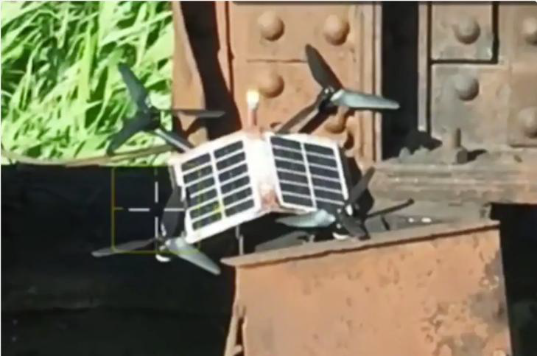
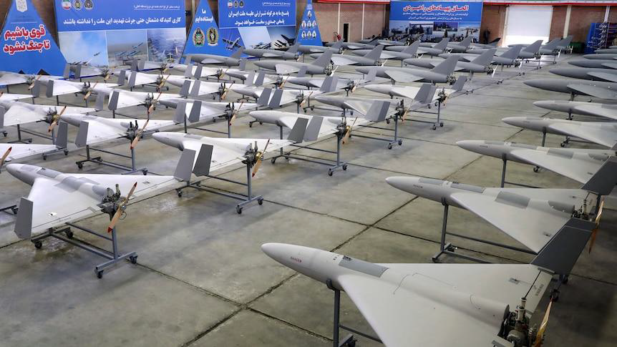
The $10,000 Problem:
A New Military-Economic Reality
A $10,000 AI-equipped drone now performs missions that previously required a $3 to $5 million missile. This is a global doctrine shift, visible in the Gulf, Ukraine, and Taiwan planning right now.
Intercepting one Iranian Shahed drone with a Patriot missile costs roughly $3 to $4 million. The US and Gulf states are already looking for cheaper options because the current economics are unsustainable
In Ukraine, drones cause over 70% of casualties. The attacker iterates in 48 to 72 hours; the defender procures over years
China is incorporating mass autonomous systems into its Taiwan planning
precisely because the cost asymmetry makes conventional defense prohibitively expensive at scale
© Headspring Executive Development
A joint venture of FT | IE Business School

Slide 22
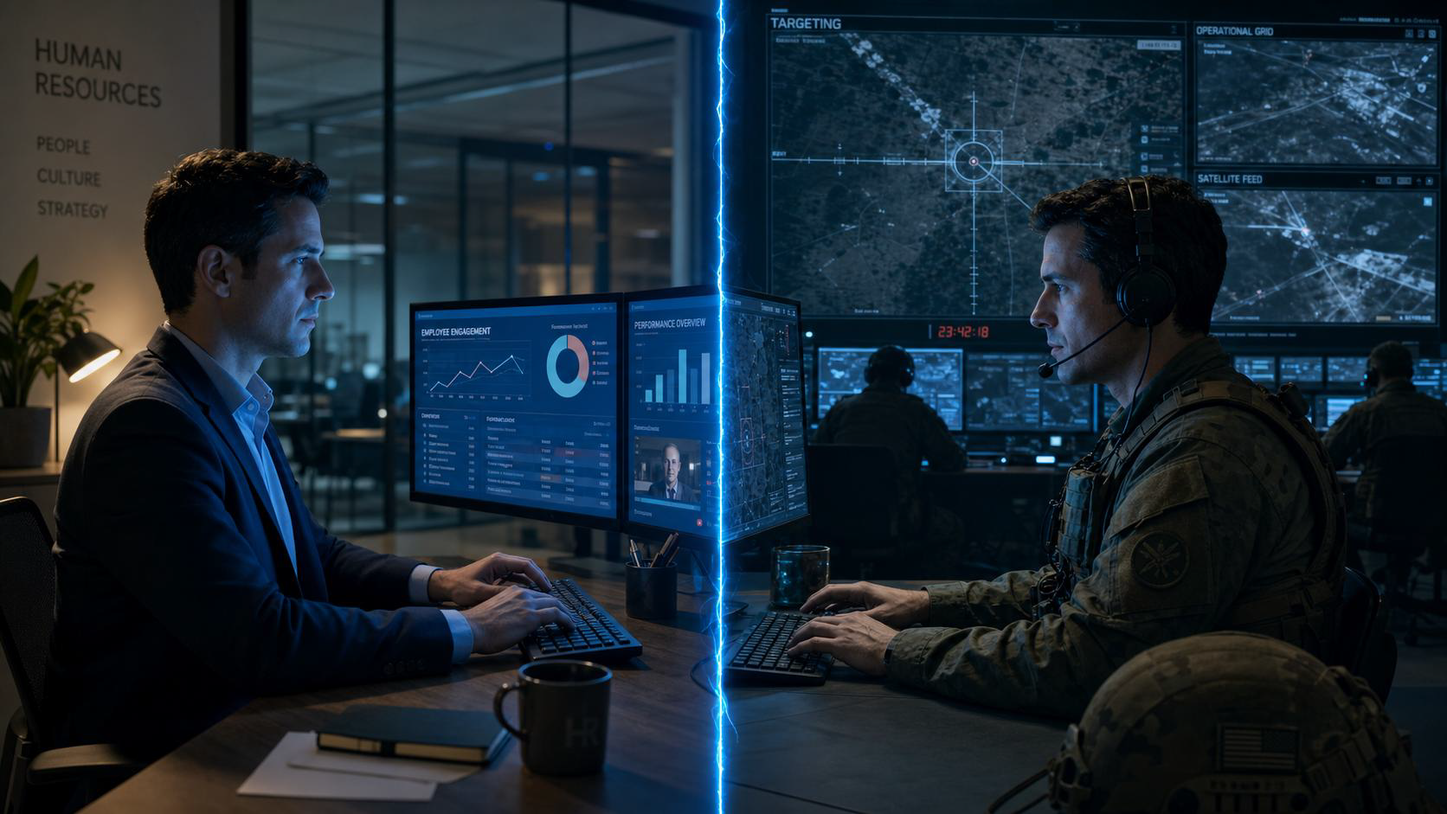
The Unconscious Combatant
AI is the first General Purpose Technology (GPT) in history that is dualuse
at birth. Electricity arrived as civilian. Nuclear arrived as military. AI
arrived as both, simultaneously, on day one.
© Headspring Executive Development
A joint venture of FT | IE Business School

Slide 23
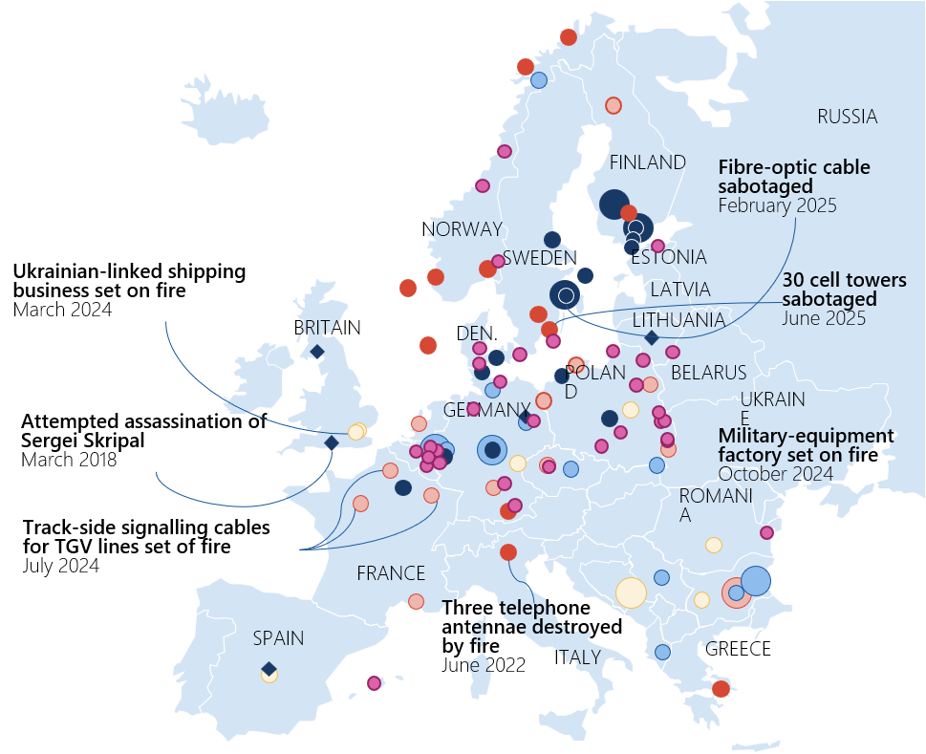
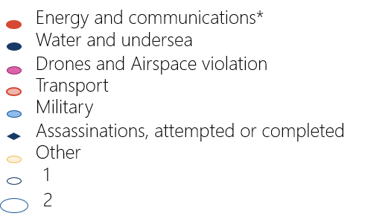
Deliberate Disruption of Digital Infrastructure
Russian hybrid warfare attacks against critical infrastructure in Europe between January 2018 and November 2025
Talent as Strategic Asset:
AI engineers, semiconductor specialists, and
cryptographers are being contested by states. Your
talent pipeline is inside a geopolitical competition
whether you acknowledge it or not.
Cybersecurity Is an HR Risk:
The first large-scale AI-autonomous cyberattack
performed reconnaissance, credential harvesting, and
data extraction without human operators. Your
workforce's digital hygiene is a national security
variable.
Supply Chain Is Workforce:
When a Gulf disruption hits logistics costs or Taiwan
tensions freeze chip supply, the people managing
workforce consequences are in HR. Disruption
planning belongs in your function.
© Headspring Executive Development
A joint venture of FT | IE Business School

Slide 24

Geopolitical Literacy Is a Leadership Competency:
If geopolitical risk is a board-level variable, the executive development curriculum must reflect it. You cannot build a resilient leadership pipeline by training people only for market cycles and people processes.
AI Governance Is a Human Resources Question:
The same foundation models powering enterprise HR tools have been contracted by the Pentagon for military operations. The ethical frameworks and governance structures are questions HR, Legal, and the Board must answer together. Leaving it to IT alone is a governance failure.
Resilience Is the New Retention:
In an era of permanent geopolitical friction and AI-generated disinformation, employee trust in institutions is a strategic asset. Psychological safety is no longer a soft metric. It is an organisational resilience variable with a direct line to performance.
Three Frameworks
© Headspring Executive Development
A joint venture of FT | IE Business School

Slide 25

© Headspring Executive Development
A joint venture of FT | IE Business School

Slide 26



Q&A
© Headspring Executive Development
A joint venture of FT | IE Business School

Slide 27

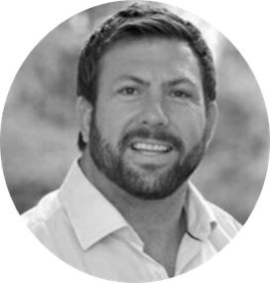
CLARITY OVER UNCERTAINTY​
For over 130 years, the Financial Times has delivered deep analysis on the forces shaping global business. IE Business School has redefined business education through relentless innovation, consistently ranking among the world’s best.
​
Together, they power Headspring — a strategic learning partner born from this alliance.​
At Headspring, we combine FT’s fearless journalism with IE’s excellence in business education to equip leaders with clarity to grow and transform businesses.
NICK WINWOOD​
​
Vice President, Corporate Partnerships​
​
Headspring
© Headspring Executive Development
A joint venture of FT | IE Business School

